Slide 1

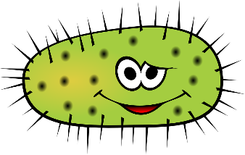
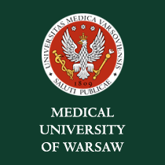
Microbiome-derived molecules as markers and mediators in cardiovascular diseases.
Marcin Ufnal MD, PhD
Medical Univeristy of Warsaw, Poland
Department of Experimental Physiology and Pathophysiology
^{www.physiology.wum.edu.pl}

Slide 2
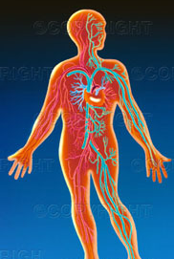
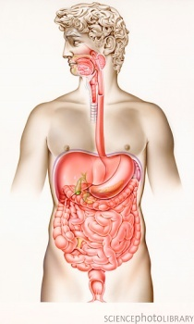
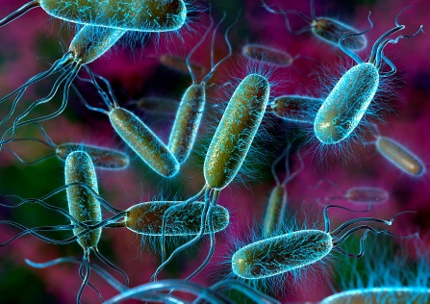
Gut bacteria metabolites – mediators in the circulatory system ?
Hydrogen sulfide, methane, nitric oxide, carbon monoxide, indoles, SCFA (acetic, propionic, butyric), and TMA/TMAO

Slide 3
Mechanisms of bacteria-host interaction

Slide 4
Disturbances in bacterial metabolites production and cardiovascular diseases ?
Cardiovascular Diseases

Slide 5
Hypertension (high systemic blood pressure) - complications

Slide 6
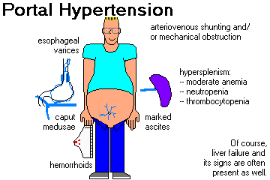
Portal hypertension, systemic hypotension - high mortality in liver cirrhosis

Slide 7
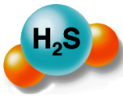

Slide 8
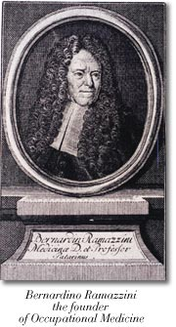
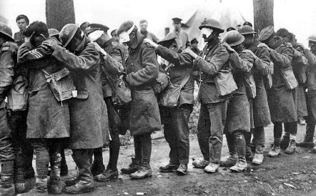
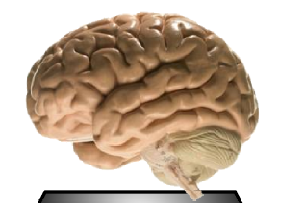
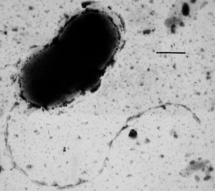
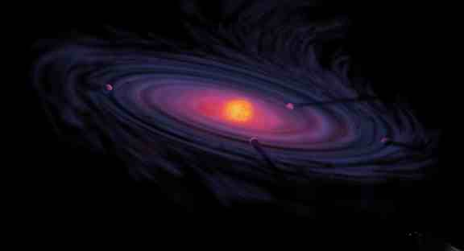
H₂S – a historic perspective
Earth formed around 4.54 billion years ago
Sulfur bacteria
3.4 billion years ago
Ramazzini
„De Morbis Artificum
Diatriba”
(1713 AD)
1916 British Army
1996 Abe and Kimura
Notes:
3.4 billion years ago earth was oxygen free world.
The purple sulfur bacteria and the green sulfur bacteria use hydrogen sulfide as electron donor in photosynthesis, thereby producing elemental sulfur. (In fact, this mode of photosynthesis is older than the mode of cyanobacteria, algae, and plants, which uses water as electron donor and liberates oxygen.)
Such bacteria are still common today. sulfur bacteria are found in smelly ditches, soil, hot springs, hydrothermal vents -- anywhere where there's little free oxygen and they can live off organic matter,'
De Morbis Artificum
Diatriba (“Diseases of Workers”) published in 1713 by the Italian physician Bernardino Ramazzini, who described the toxic effects of the gas in victims of the occupational exposure
Hydrogen sulfide was used by the British Army as a chemical weapon during World War I. It was not considered to be an ideal war gas, but, while other gases were in short supply, it was used on two occasions in 1916.
Abe, K.; Kimura, H. The possible role of hydrogen sulfide as an endogenous neuromodulator. J. Neurosci., 1996, 16(3), 1066-1071.

Slide 9
H₂S – Endogenous production in mammalian cells
CBS - cystathionine -$β$synthase; CSE - cystathionine $γ$ -lyase; MST, 3-mercaptopyruvate sulfurtransferase, CAT, cysteine aminotransferase.
Notes:
Hydrogen sufide is formed in a series of reactions of amino acid metabolism. -

Slide 10
Exogenous source
GI system
(sulfate-reducing bacteria
in the large intestine
- Desulfovibrio, Desulfobacter,
Desulfomonas)
Desulfovibrio

Slide 11
Gut bacteria production of H₂S
Tomasova (…), Ufnal, Nitric oxide 2016

Slide 12
Does gut-derived H₂S affect the systemic and portal blood pressure?

Slide 13
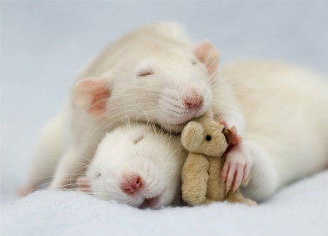
Methods
Anesthetized SD rats
Intracolonic administration of 0.9% NaCl or H₂S donor
15 min baseline
90 min
Portal blood pressure, arterial blood pressure,
Portal blod flow
Notes:
0,2-2 mmol\kg mc
30-300 mg/kg, 9 * H2O

Slide 14
Colonic H₂S increases portal blood pressure while decreasing arterial blood pressure
Tomasova (…), Ufnal, Nitric oxide 2016
Huc (…), Ufnal, Exp Biol Med 2018 243(1):96-106

Slide 15
Colonic H₂S increases portal blood pressure by increasing the liver resistance
Huc (…), Ufnal, Exp Biol Med 2018 243(1):96-106

Slide 16
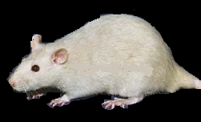
Animal model of liver cirrhosis
Sprague-Dawley rats were maintained on water solution of thioacetamide (CRH-R).

Slide 17
Portal blood pressure (mmHg) | 6.0±0.3 | 11.1±0.2
Mean arterial blood pressure (mmHg) | 101.3±2.0 | 84.9±1.9

Slide 18
Methods
Anesthetized controls and CRH-rats
Intracolonic / intraportal administration of 0.9% NaCl or H₂S donor
15 min baseline
90 min
Portal blood pressure, arterial blood pressure,
Notes:
0,2-2 mmol\kg mc
30-300 mg/kg, 9 * H2O

Slide 19
CRH-R showed significantly greater responses than controls to intracolonic H₂S
Huc (…), Ufnal, Exp Biol Med 2018 243(1):96-106

Slide 20
Liver H₂S levels
(liver homogenate incubation with L-cystein)
CRH-R showed a significantly higher concentration of H₂S than controls
*
nmol H2S•g /h-1
CRH-R
Controls

Slide 21
TST- Rhodanese; CTH- γ-Cystathionase; CBS- Cystathionine-β-synthase; MPST- 3-Mercaptopyruvate sulfurtransferase.
CRH-R showed lower expression of rhodanese,
an enzyme converting H₂S to sulfate.
Convertion of
H₂S to sulfate
H₂S synthesis

Slide 22
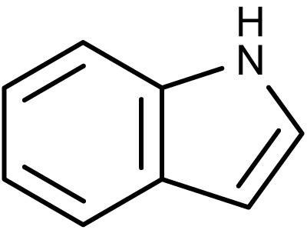
Indole

Slide 23
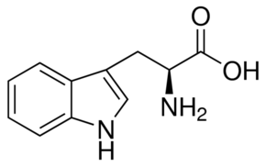
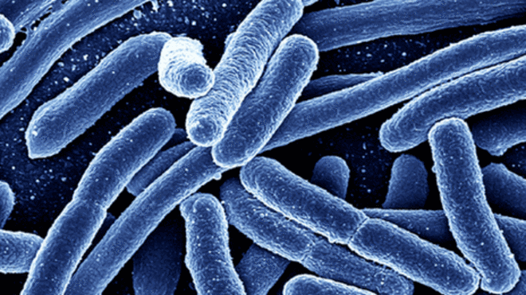
Indole
Various bacteria metabolize trypthophane and form indole (e.g. E. coli).
trypthophane
Indole

Slide 24
Indole

Slide 25
Does gut-derived H₂S affect the systemic and portal blood pressue?

Slide 26
Indole administered into the colon increases portal blood pressure
Huc (…), Ufnal, Am J Physiol Regul Integr Comp Physiol. 2018

Slide 27
Cirrhotic rats show increased penetration of indoles to portal blood
 | Portal Blood |  | Peripheral Blood
 | SD | SD-PH | SD | SD-PH
Indole | 2.92±0.77 | 11.22±2.0* | 2.68±0.7 | 11.72±2.29*
Indoxyl |  |  | 44.89±5.94 | 24.27±2.13*
3-IAA | 0.15±0.02 | 0.3±0.04* | 0.11±0.02 | 0.3±0.03*
3-IPA | 0.31±0.07 | 1.31±0.15* | 0.32±0.05 | 1.31±0.18*
3-ILA | 1.15±0.07 | 2.19±0.08* | 1.28±0.08 | 2.32±0.12*
Huc (…), Ufnal, Am J Physiol Regul Integr Comp Physiol. 2018

Slide 28
Tryptophan-rich diet increases indole portal blood level and portal blood pressure
 | TPR-free | TPR-rich
 | Hemodynamics
PBP | 6.92±0.47 | 8.49±0.31*
MABP | 97.40±2.35 | 105.23±4.99
 | Portal blood
Indole | 0.08±0.005 | 1.48±0.10*
3-IAA | 0.02±0.004 | 0.43±0.02*
3-IPA | 0.21±0.04 | 1.82±0.10*
3-ILA | 1.24±0.12 | 1.51±0.03*
TRP | 6.87±0.41 | 30.90±3.27*
 | Peripheral blood
Indole | 0.07±0.003 | 0.51±0.03*
Indoxyl | 2.17±0.39 | 6.22±0.57*
3-IAA | 0.02±0.003 | 0.31±0.02*
3-IPA | 0.2±0.02 | 0.91±0.05*
3-ILA | 0.36±0.02 | 1.48±0.01*
TRP | 7.01±0.52 | 27.05±1.48*
Huc (…), Ufnal, Am J Physiol Regul Integr Comp Physiol. 2018

Slide 29
Conclusions
Tryptophan-rich diet, colonic indole and H₂S increase portal blood pressure.
Colonic indole and H₂S production may be of therapeutic importance in PH ? arterial hypertension ?

Slide 30
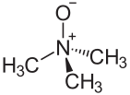
Trimethylamine N-oxide (TMAO)

Slide 31
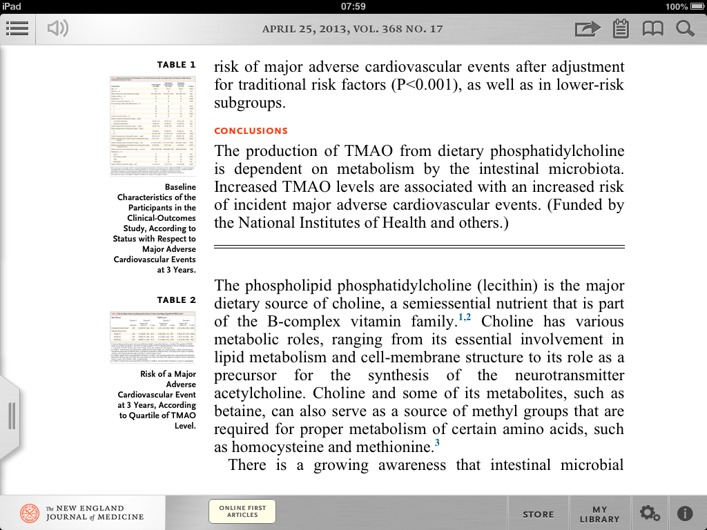
TMAO and cardiovascular risk

Slide 32
Is TMAO a foe?

Slide 33
TMAO and cardiovascular risk
Positive correlation between elevated plasma TMAO and an increased cardiovascular risk (humans)
inhibition in substrate-dependent respiration, leading to a decrease in beta-oxidation of fatty acids (rats)
Modulates cholesterol and sterol metabolism promoting progress of atherosclerosis (rats)

Slide 34
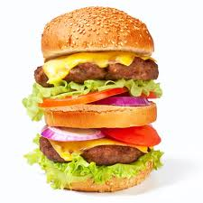

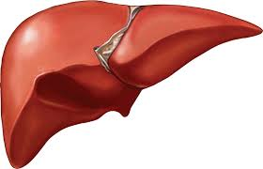
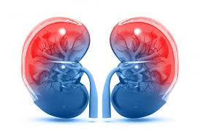
Origins of plasma TMAO (1)
Gut-blood barrier
L-carnitine and phosphatidylcholine
TMA
Liver (FMO3)
Gut bacteria
TMAO
PLASMA TMAO + TMA
Kidneys
Urine TMAO + TMA

Slide 35
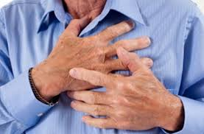
TMAO and cardiovascular risk
TMAO - a link between high red meat consumption and cardiovascular diseases ?
Koeth RA et al. Nature medicine. 2013;19:576-585

Slide 36


Slide 37
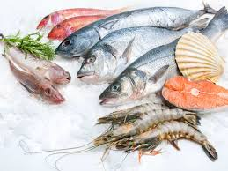
Origins of plasma TMAO (2)
L-carnitine and phosphatidylcholine
TMA
Liver (FMO3)
Gut bacteria
TMAO
TMAO
PLASMA TMAO
Kidneys
TMAO-rich diet (e.g. seafood )
Urine TMAO

Slide 38
Higher plasma TMAO was found after ingestion of fish and vegetarian diet than after ingestion of red meat and eggs.
Fish-rich and vegetarian diet is neutral or even beneficial for reducing cardiovascular risk
Red-meat-rich diet is thought to increase the cardiovascular risk.

Slide 39
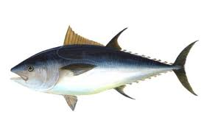
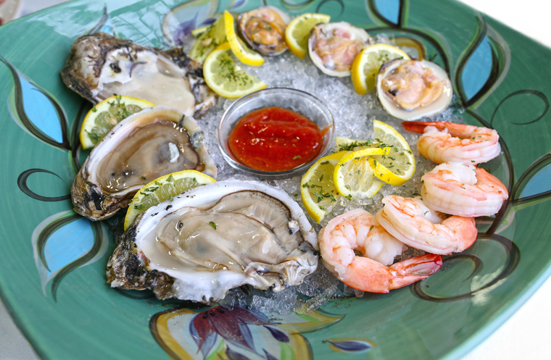
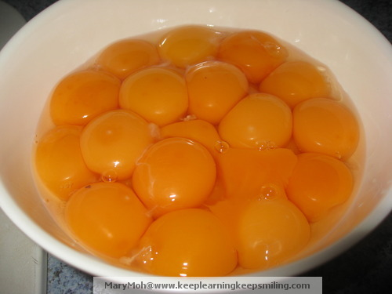
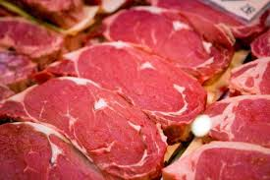
Is TMAO a harmful or a beneficial molecule, or both ?

Slide 40

No toxic effects of TMAO in rats
(two week treatment)
Ufnal et al. Can J Cardiology, 2014

Slide 41
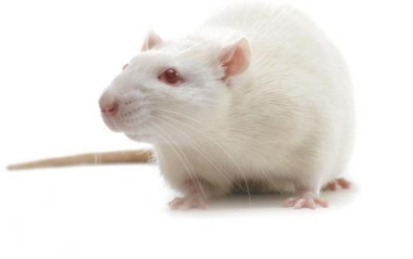
The effects of TMAO on the development of hypertension and its complications in SHR

Slide 42
Experimental groups
Normotensive healthy (WKY)
Hypertensive rats (SHR)
SHR treated with TMAO: low-dose chronic (56-week) treatment

Slide 43
TMAO treatment increased plasma TMAO by 4-5-fold, and did not affect the development of hypertension in SHR.
Huc (…), Ufnal, Am J Physiol Heart Circ Physiol 2018

Slide 44
SHR treated with TMAO showed significantly lower plasma NT-proBNP and lower LVEDP.
TMAO improved diastolic cardiac function
Huc (…), Ufnal, Am J Physiol Heart Circ Physiol, 2018

Slide 45
SHR-TMAO showed significantly lower cardiac fibrosis.
Huc (…), Ufnal, Am J Physiol Heart Circ Physiol 2018

Slide 46
Conclusions TMAO (1)
4-5-fold increase in plasma TMAO does not exert negative effects on the circulatory system i SHR.
In contrast, increased dietary TMAO seems to reduce diastolic dysfunction in pressure-overloaded heart in rats.

Slide 47
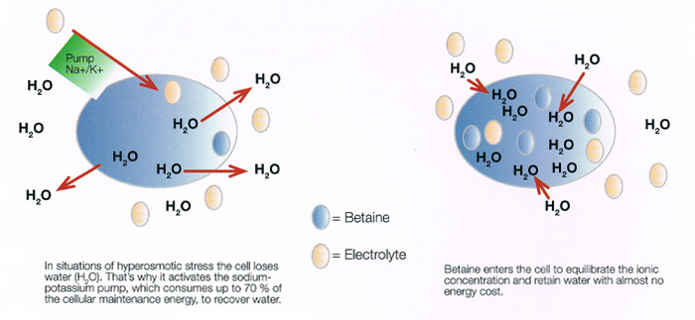
TMAO as an osmolyte and a piezolyte.
TMAO
Osmolytes are used by cells to maintain cell volume when exposed to osmotic and hydrostatic pressure stresses.
Piezolytes protect against hydrostatic pressure stress.
Yancey PH. The Journal of experimental biology. 2005;208:2819-2830

Slide 48

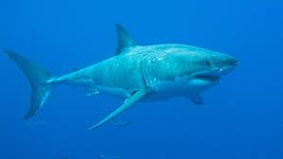
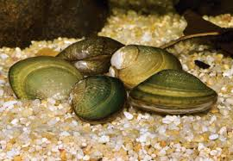
TMAO blood level in Humans: 3-8 µmol/L
TMAO blood level in deep-sea animals ranges from 100 to 300 µmol/L.
Yancey PH. The Journal of experimental biology. 2005;208:2819-2830

Slide 50

Is TMAO a friend ?

Slide 51
Is TMAO a foe?

Slide 52



"All substances are poisons; there is none which is not a poison. The right dose differentiates a poison…."
Paracelsus (1493-1541)

Slide 53
Why plasma TMAO is increased in CVDs?

Slide 54
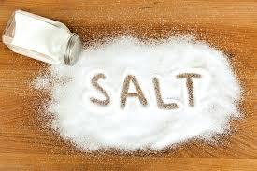
Modifiers of Cardiovascular Risk and TMAO

Slide 55
Plasma TMAO and Salt
Gut-blood barrier
L-carnitine and phosphatidylcholine
TMA
Liver (FMO3)
Gut bacteria
2
1
TMAO
3
4
PLASMA TMAO
Kidneys
Urine TMAO

Slide 56
High-salt intake alters gut bacteria composition
Control
Medium-sodium intake
High-sodium intake
Bielinska K, (…), Ufnal M. Nutrition 2018

Slide 57
High-salt intake increases plasma TMAO
Control
Medium sodium intake
High sodium intake
Bielinska K, (…), Ufnal M. Nutrition 2018

Slide 58
High-salt intake does not affect stool TMA
Control
Medium sodium intake
High sodium intake
Bielinska K, (…), Ufnal M. Nutrition 2018

Slide 59
High-salt intake deacreases 24hr urine TMAO output
Control
Medium sodium intake
High sodium intake
Bielinska K, (…), Ufnal M. Nutrition 2018

Slide 60
Conclusions TMAO (2)
High-salt intake increases plasma TMAO by decreasing TMAO urine output.
Accumulation of TMAO ?
Response to osmotic stress ?
Is TMAO a protective factor (compensatory response ?)

Slide 61
TMAO and cardiovascular risk ?

Slide 62
Conclusions TMAO (final)
Increased plasma TMAO is a marker of increased cardiovascular risk (simillar as BNP ?)
TMAO is not a deleterious molecule („real life” concentrations)
Is TMAO a protective factor (compensatory response ?)

Slide 63
Are gut bacteria metabolites mediators in the circulatory system ?
YES, they are !

Slide 64

Are gut bacteria metabolites markers of CVDs ?

Slide 65
The gut-blood barrier (GBB)
The access of gut-bacteria products to the circulation is protected by the GBB,
a complex multilayer system

Slide 66
Are gut-blood barrier functions compromised in cardiovascular diseases ?

Slide 67
The effect of hypertension and heart failure on the gut-blood barier

Slide 68
Experimental groups
Normotensive healthy (WKY)
Hypertensive rats (SHR)
Heart failure rats (SHHF/MccGmiCrl-Leprcp/Crl)

Slide 69
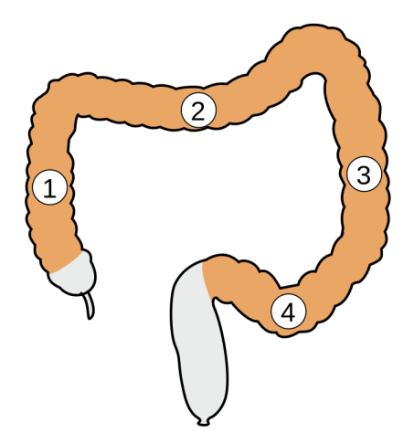
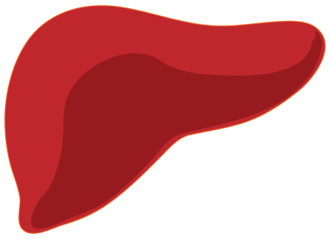
Methods
Gut-blood barrier permeability to TMA
TMA
TMA oxidation
(FMO 3)
TMA
TMAO + TMA
Portal vein
Hepatic veins confluence
24hr urine TMAO + TMA
TMA colon
content (stools)
liver
Blood sampling
Blood sampling

Slide 70
Conclusions TMAO
Hypertensive rats (SHR) ¹ and
heart failure rats (SHHF) ²
show increased gut-to-blood penetration of TMA, a TMAO precursor
¹ - Jaworska K (…), Ufnal M. PLoS One. 2017
² – Konop M (…) Ufnal M, 2018 submitted

Slide 71
The gut-blood barrier permeability - A new marker in cardiovascular diseases?
Ufnal M, Pham K. Med Hypotheses. 2017

Slide 72
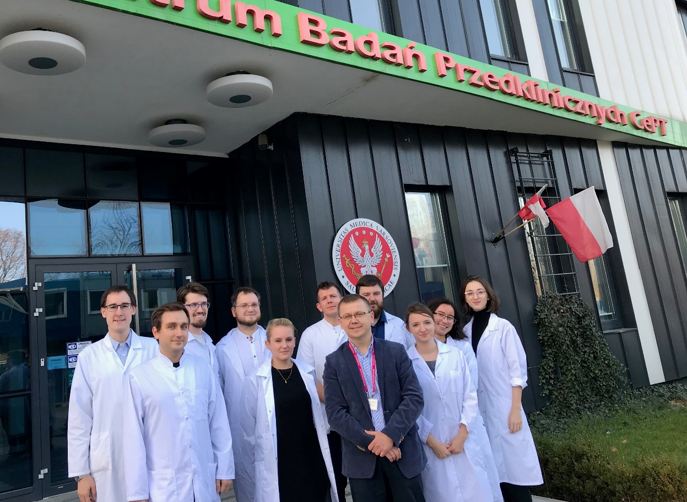

Acknowledgments
Tomasz Huc (1)
Kinga Jaworska (1)
Adrian Drapala (1)
Emilia Samborowska (2)
Leszek Dobrowolski (3)
Lenka Tomasova (1)
Artur Nowinski (1)
Klaudia Bielinska (1)
Marta Gawrys (1)
Janusz Skrzypecki (1)
Marek Konop (1)
Izabella Mogilnicka (1)
Maksymilian Onyszkiewicz (1)
¹ Department of Experimental Physiology and Pathophysiology, Laboratory of Centre for Preclinical Research, Medical University of Warsaw, Warsaw, Poland
² Mass Spectrometry Laboratory, Institute of Biochemistry and Biophysics, Polish Academy of Sciences, Warsaw, Poland
³ Department of Renal and Body Fluid Physiology, M. Mossakowski Medical Research Centre, Polish Academy of Sciences, Warsaw, Poland

Slide 73
Acknowledgments
    grants no:
    2015/19/N/NZ5/00650
    2016/21/B/NZ5/02544
    2016/22/E/NZ5/00647
Ministry of Science and Higher Education POLAND
    grants no:
    DI2017 009247
    DI2016 007346

Slide 74
Thank you for your attention.
Department of Experimental Physiology and Pathophysiology,
Laboratory of Centre for Preclinical Research,
Medical University of Warsaw, Poland.
^{physiology.wum.edu.pl}
mufnal@wum.edu.pl

