Slide 1
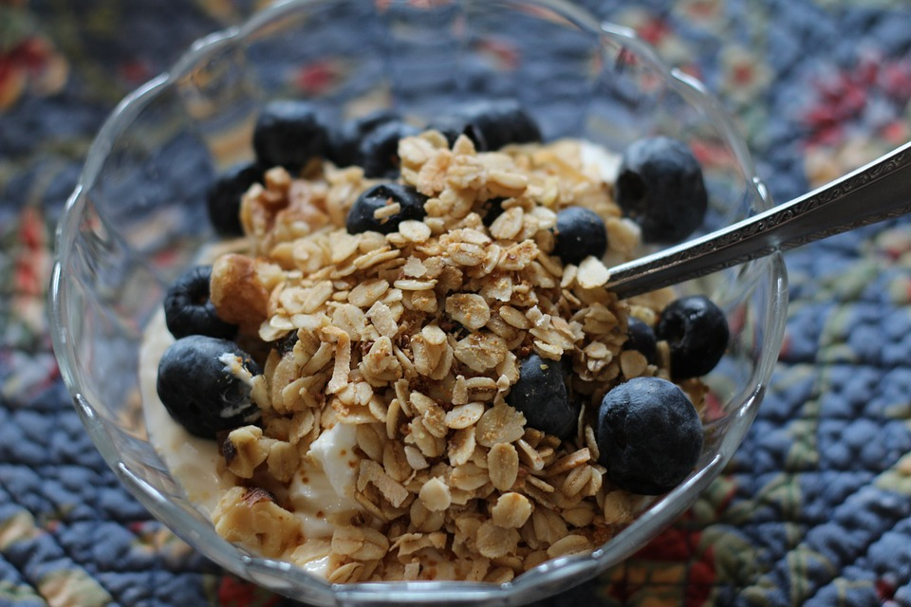
Food, Microbiome and Regulatory Paths Forward
C. Shortt, J&J Consumer
Importance of Microbiota in Human Health, Warsaw, Nov 2018

Slide 2
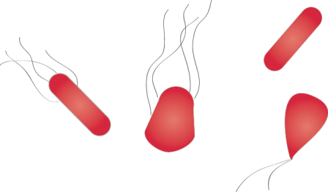
Host-microbe nexus is key to unlocking the microbiome’s potential
Host
Microbe
Traditional
Approach:
Modulate Host
Response
Traditional
Approach:
Microbial
Eradication
A spectrum of new health enhancing foods and transformative treatments
MB OPTIMIZED FOODS
& INGREDIENTS/
PERSONALISED
FOODS & DIETS
COCKTAILS OF MICROBES TO CORRECT DYSBIOSIS
PRECISION EDITING OF
MICROBIOTA
VACCINES TO RE-TRAIN HOST IMMUNE RESPONSE
FMT
FOODS
FOR SPECIAL
GROUPS
GENETICALLY MODIFIED
MICROBES
COMPOUNDS THAT REPLICATE MICROBIAL SIGNALS
COMPOUNDS THAT TARGET HOST RESPONSE

Slide 3
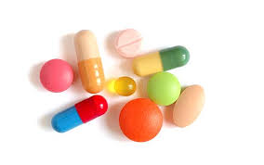



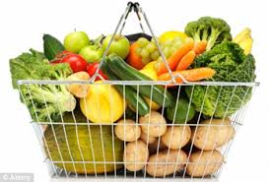
Regulatory strategy: Classification
Product type | Product | Definition
Drug/Biologics |  | A substance that acts by pharmacological, immunological, or metabolic means to treat or prevent diseases or their symptoms. An article that is intended for use in diagnosis, cure, mitigation, treatment or prevention of disease in humans or other animals
Medical Device |  | A product that treats, prevents, diagnoses, or monitors a disease but does not act via a pharmacological, immunological, or metabolic means.
Cosmetic |  | Any substance or mixture intended to be placed in contact with the external parts of the human body (epidermis, hair system, nails, lips and external genital organs with a view to exclusively or mainly to cleaning them, perfuming them ,changing their appearance, protecting them, keeping them in good condition or correcting body odours. A product ,except soap, intended to be applied to human body for cleansing, beautifying, promoting attractiveness or altering the appearance
Medical Food/ Food for Specific Medical Purposes |  | Food for special medical purposes’ means food specially processed or formulated and intended for the dietary management of patients, including infants, to be used under medical supervision
Foods/Food Supplement |  | Food’ (or ‘foodstuff’) means any substance or product, whether processed, partially processed or unprocessed, intended to be, or reasonably expected to be ingested by humans. ‘Foodstuffs which supplement the normal diet and which are concentrated sources of nutrients or other substances with a nutritional or physiological effect, alone or in combination, marketed in dose form Note: Definitions are region specific and the above are general examples

Slide 4

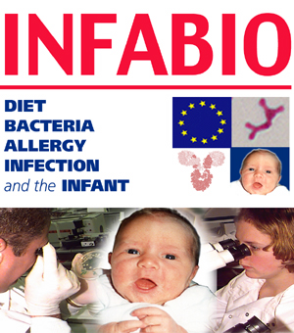

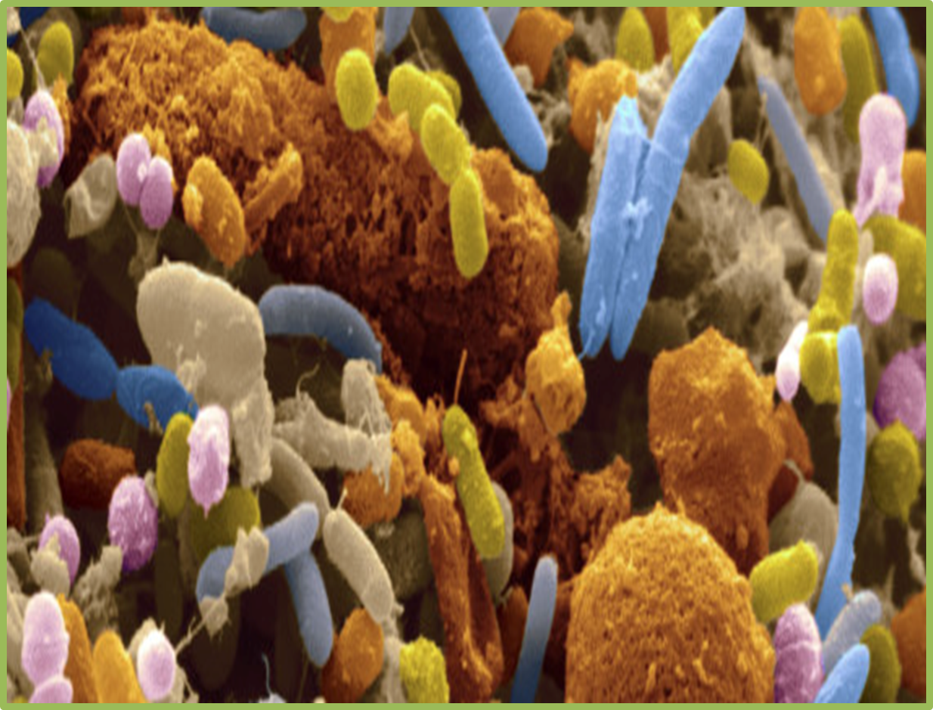
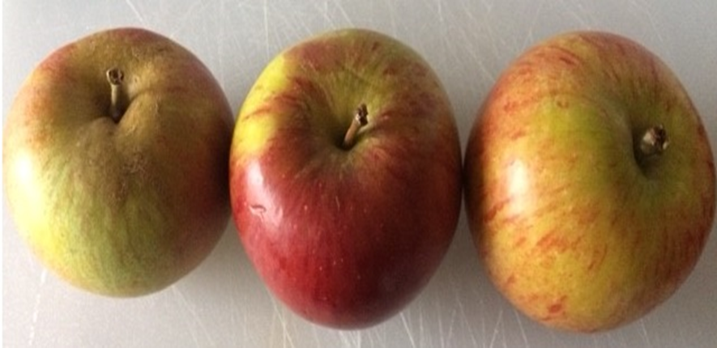
Diet Intestinal Flora Inter-play
Metabolic potential
    Reduction
    Hydrolysis
    Polysaccharide ….fermentation
    Dehydroxylation
    Methylation
Intestinal flora
Diet/dietary constituents
Protein
CHO
Fat
Fibre
Probiotics
Prebiotics
Polyphenols
Other….
  Demethylation
  Deamination
  Nitrosation
  Ring fission
  Aromatization
  Oligomer-breakdown
Shortt et al Eur J Nutr 18; 57(1): 25

Slide 5
Carbohydrate Fermentation
Polysaccharides Oligosaccharides Mucins
NSP/Resistant starch
Microbial fermentation
Short chain fatty acids
H₂ CO₂
Lactate
Acetate
Propionate
Butyrate
Methanobrevibacter
smithii
CH₄
H₂S
Most gut organisms
Eubacterium hallii
Roseburia
Coprococcus catus
Megasphera elsdenii
Veillonella spp
Ruminococcus obeum
Bacteroidetes
Eubacterium rectale
Eubacterium hallii
Roseburia spp
Coprococcus spp
Faecalibacterium prausnitzii
Bifidobacterium spp
Lactobacillus spp
Desulfovibrio spp
Adapted from Rowland et al Eur J Nutr (2018) 57 (1): 1

Slide 6

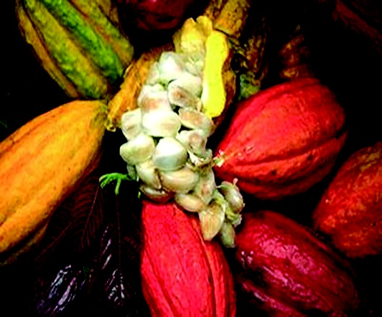

Polyphenols
Widely available in the diet: Isoflavonoids; (daidzein to equol); Naringin; Anthocyanins; Lignans;Tea catechins; Rutin
Often poorly absorbed in small intestine ➔ colon
Large interindividual variations in absorption and excretion ascribed to differences in gut microbiota- can have significant effects on extent of metabolism and metabolite profile.
Image pixabay
Shortt et al Eur J Nutr 18; 57(1): 25

Slide 7
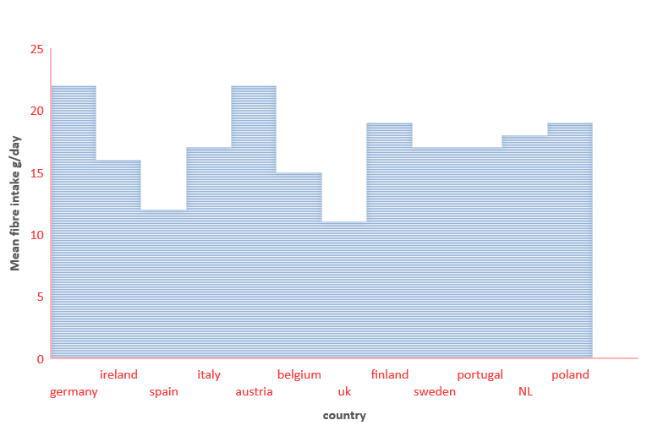
Fibre Intake of European Females
Recommended 25-38g/d
‘Many EU citizens do not meet recommended intakes of dietary fibre’
Adapted from EUSCIENCEHUB/Wuenstel, et al 2016

Slide 8

Multiple Food Regulatory Pathways
Product Classification
Claims Permitted
NONE
MAINTENANCE, IMPROVEMENT
&
RISK Factor REDUCTION
PREVENTION* OR MANAGEMENT
1
Medicinal product*
PHYSICIAN
Foods for Special Medical Purpose
2
Disease Manager Requirement
3
Foods for
special groups
6
Novel ingredients/
additives
Foods & Dietary
Supplements
4
consumer
5
OTC Medicine

Slide 9
Food Targets and Pathways
Foods for special medical purposes
Foods for specific groups
General foods, Food supplements, Fortified foods, Novel foods, Additives
Patients/under medical
supervision
Special population
General population

Slide 10

Food Safety
Regulation (EC) No 178 2002; Regulation EC 852 2004
Protection of human health and consumer’s interest;
‘Food shall not be placed on the market if it is unsafe’
Food GMP
Risk analysis
Traceability
HACCP principles
Good hygiene practices
Precautionary principle

Slide 11
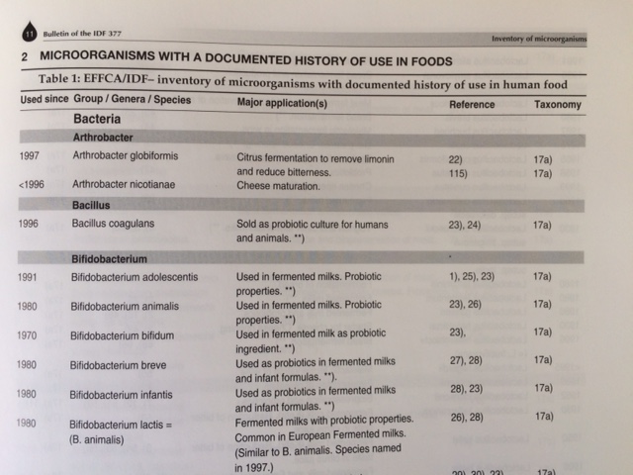
Probiotic - Novel Ingredient?
Inventory of Microorganisms with a documented History
of Use in Food
Morgensen et al 2002b Bulletin of IDF 377, 10–19.
Bourdichon et al lnternational Journal of Food Microbiology 154 (2012) 87–97
Food fermentations: Microorganisms with technological beneficial use
Notes:
saccharides

Slide 12

Novel Ingredients
Novel Food Regulation 2015/2283
Clostridium butyricum MIYAIRI 588 (CBM 588)
  Specified for food supplements
  Max level 1.35 x 10⁸ cfu/d
Lacto-N-neotetraose
2’ fucosyllactose
  Wide range of foods
  Max infant formula 1.2g/L
Galacto-oligosaccharides
  Wide range of foods
  Max variable
Notes:
saccharides

Slide 13
EC Health Claim Framework
- EC 1924 2006, determines the claims that can be made
- Establishes the lists of nutrition & generally accepted claims
-Establishes the procedure for the authorisation of new claims
NUTRITION CLAIMS
Health Claim
Based on generally accepted scientific data
Other (e.g. based on new scientific data or proprietary data)
Reduction of disease risk/Children’s development & health
List of approved nutrition claims
List of approved generic Health
Authorisation procedure through EFSA

Slide 14
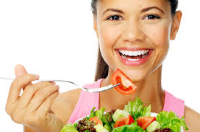
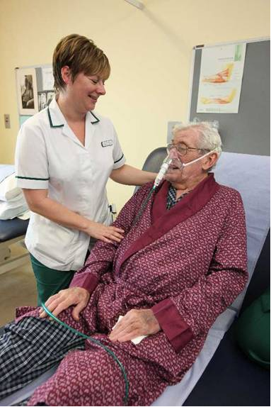
Claim Continuum
Healthy
Medical food
Dietary management of disease/condition
Medicine/OTC medicine
Food- risk factor reduction claim
Food-health claim
Lowers X. High X is a risk factor in the development of disease
Helps maintain /supports…..
Treat, Cure, Prevent inflammatory bowel disease [disease/condition]
Compromised health

Slide 15
Article 14
Disease risk-reduction claims
Authorised prior to marketing on a case by case basis
Any claim that states, suggests or implies, that the consumption of a food category, food or one of its constituents significantly reduces a risk factor in the development of a human disease
Based on application (dossier) submitted to EFSA
EFSA carries out individual assessment and issues opinion → Commission approves or rejects (comitology)

Slide 16
EC Health Claim Requirements
Characterisation of ingredient
The study group is representative of the target population
A cause and effect relationship exists
The effect is relevant to health
The quantity of food for the effect is reasonably achieved as part of a balanced diet
insufficient
Demonstrate
Not relevant to health/
non beneficial effect
Lack of pertinent
human studies
Quality of studies
Non defined claims

Slide 17
Characterisation: EFSA criteria for microorganisms
  The bacterium is considered to be sufficiently characterised only when these two criteria are fulfilled
  In case of cocktail – information is required for each micro-organism. if one microorganism used in the combination is not sufficiently characterised, the combination proposed is not sufficiently characterised. From EFSA 2016
  Species identification by sequence analysis of robust taxonomic markers including at least two of them if needed (e.g. 16S rRNA gene or fully assembled and validated whole genome sequence analysis or other internationally accepted molecular methods.
  Strain identification by DNA macro restriction followed by pulsed-field gel electrophoresis, multi-locus sequence typing, randomly amplified polymorphic DNA analysis , amplified fragment length polymorphism , whole genome mapping or optical mapping analysis, fully assembled and validated whole-genome sequence analysis, or other internationally accepted genetic typing molecular methods.

Slide 18
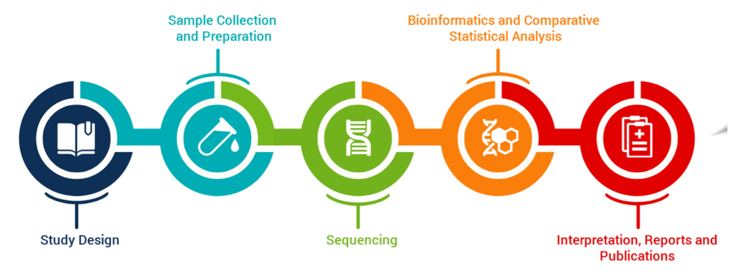
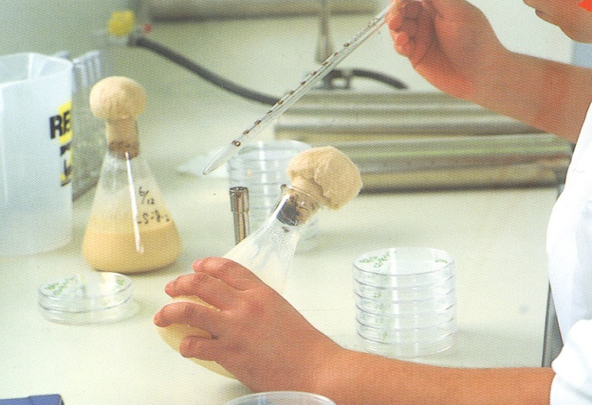
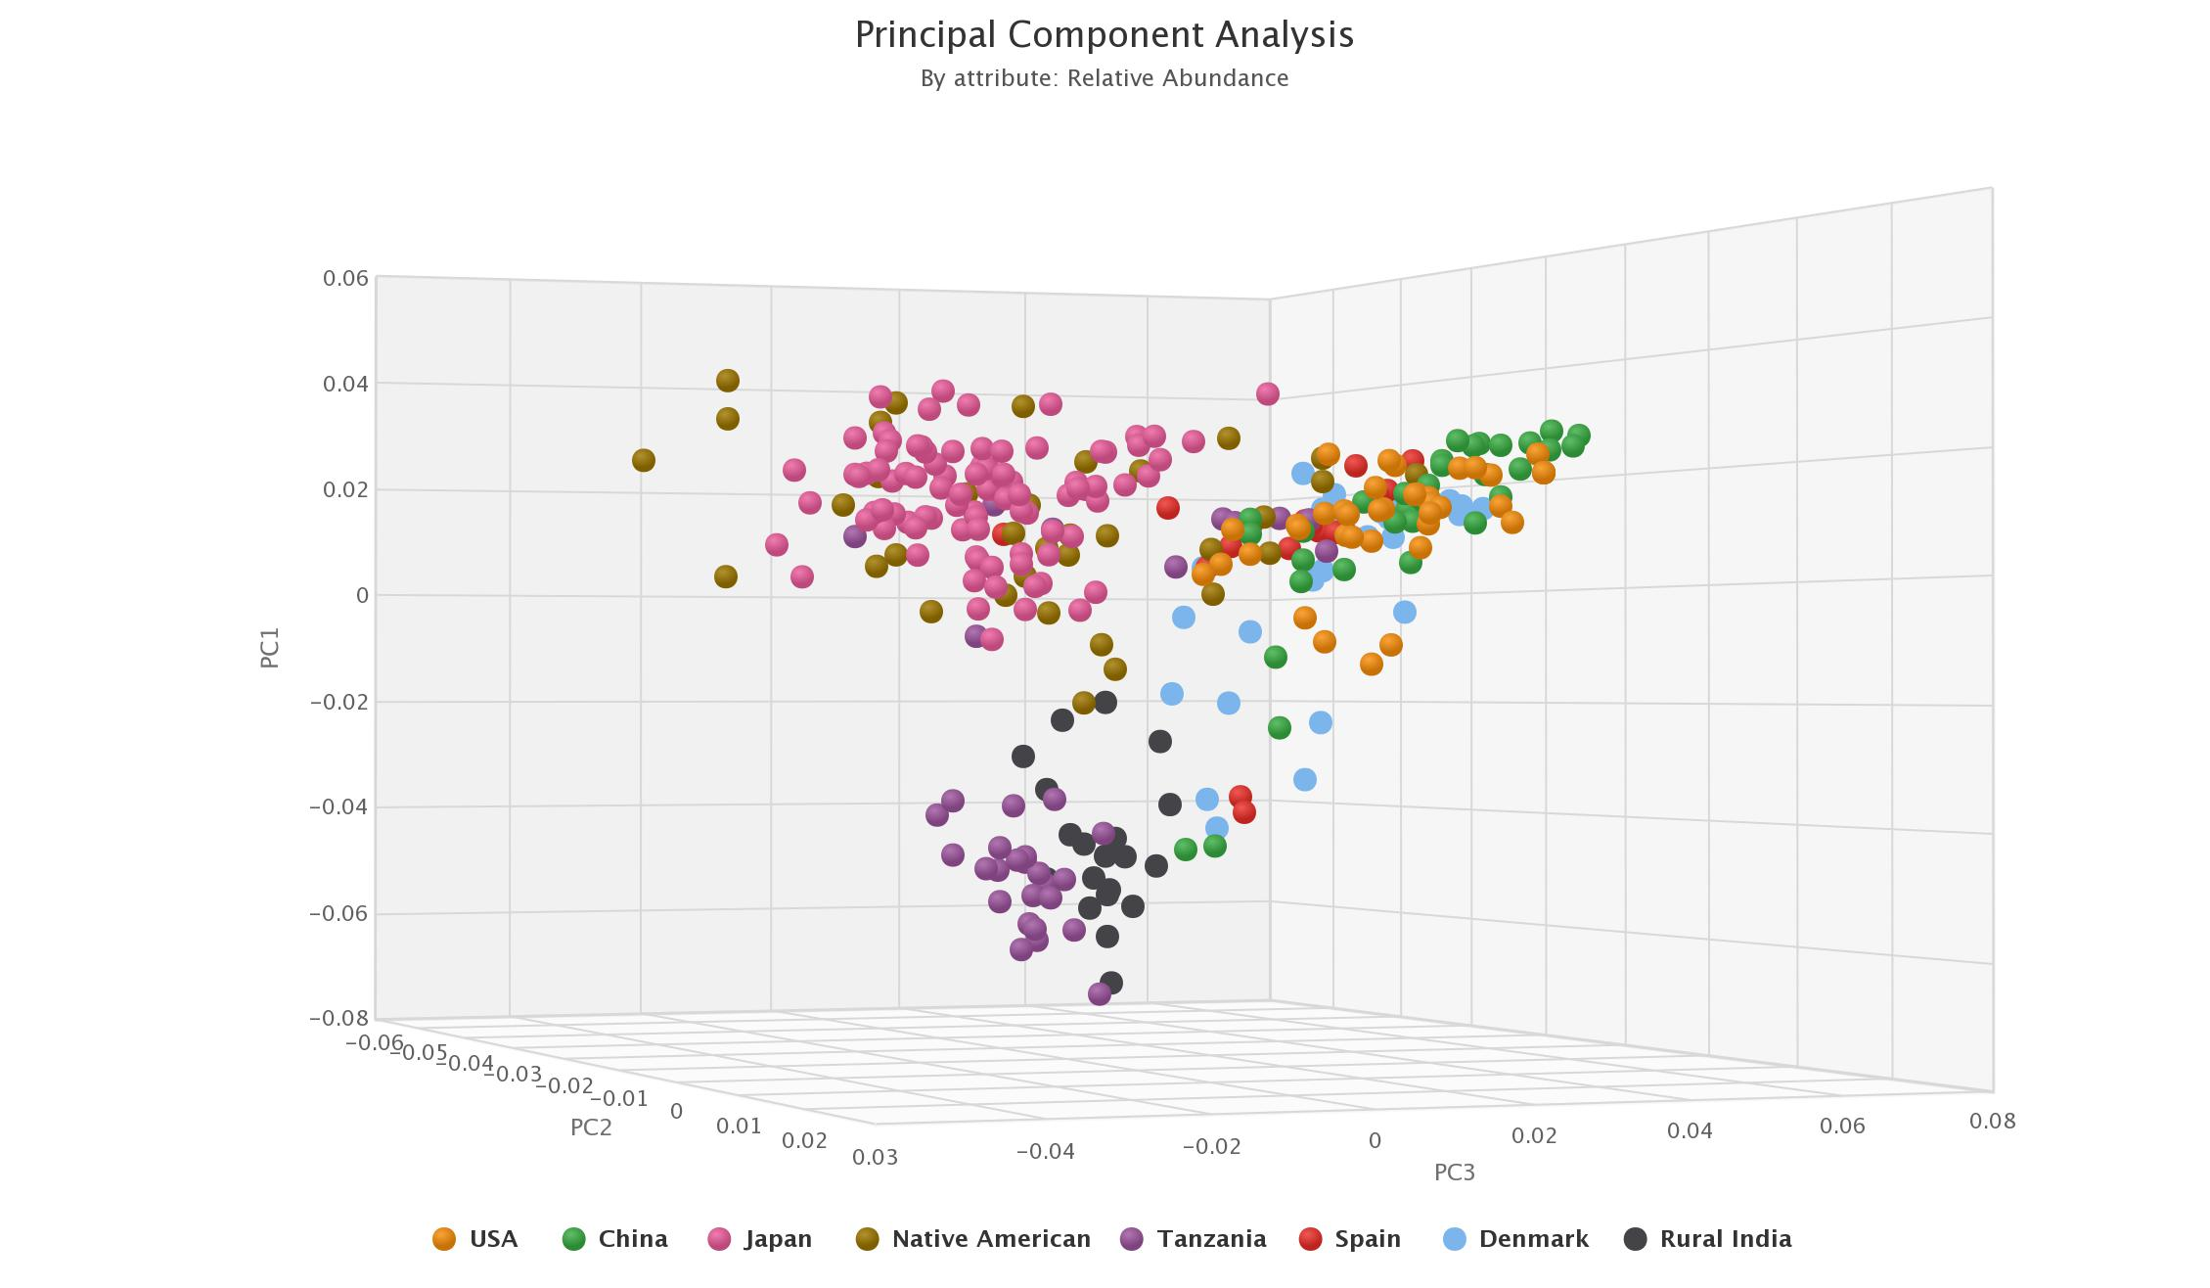
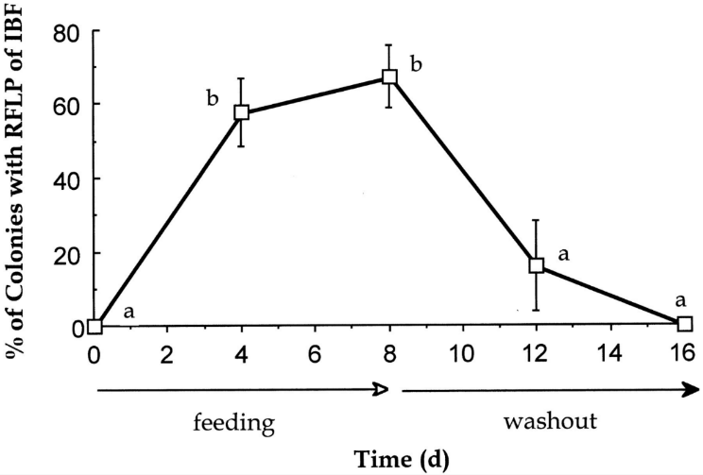

Characterisation
b
a
Survival and Differentiation of Ingested and Endogenous Bifidobacteria by DNA Fingerprinting
Adapted from a) J Nutr. 1997;127(1):89-94 ; b)
Notes:
Appearance and disappearance of ingested bifidobacteria (IBF) in the feces of six healthy men before, during and after consumption of exogenous bifidobacteria. Values are means ± SEM and are expressed as ingested bifidobacteria as a percentage of total bifidobacteria. Points denoted with different letters (a or b) differ significantly (P < 0.001). RFLP = restriction fragment length polymorphism.
18

Slide 19


Microbiome plays a critical role along the wellness spectrum
DISEASE SPECIFIC SCREENS/ DIAGNOSTICS
Additional opportunities for interception and prevention
HEALTH
PERSONALIZED NUTRITION PRESCRIPTIONS (foods/diets)
MB PROFILING
OPTIMIZED FOODS/
FS -/+ HEALTH CLAIMS/
NOVEL FOODS/INGREDIENTS/
FOODS for SPECIAL GROUPS
FOODS for SPECIAL MEDICAL
PURPOSE
Observable Symptoms of Disease
CONSUMER PRODUCTS THAT MANAGE SYMPTOMS
NEXT-GEN PREBIOTIC
SUPPLEMENTS
DISEASE
MB THERAPEUTIC COCKTAILS
Microbiome Solutions Along An Individual’s Health Journey

Slide 20
Synbiotics and Sepsis in India
4,556 infants enrolled at birth and with no signs of sepsis or other morbidity
Monitored for 60 days.
Significant reduction in the primary outcome (combination of sepsis and death) in the treatment arm (risk ratio 0.60, 95% confidence interval 0.48–0.74), with few deaths (4 placebo, 6 symbiotic)
.
P<0.001
L. plantarum ATCC-202195 + FOS
*
*
Panigarthi et al Nature 2017

Slide 21

‘Gut Bacteria Selectively Promoted by Dietary Fibers Alleviates T2D’
Randomized study with specially designed isoenergetic diets, together with fecal shotgun metagenomics showed that a select group of 15 SCFA-producing strains was promoted by dietary fibers in patients with T2DM.
When the fiber-promoted SCFA producers were present in greater diversity and abundance, participants had better improvement in hemoglobin A1c levels
Targeted restoration of these SCFA producers may present
a novel ecological approach for managing T2DM
Liping Zhao et al Science 2018

Slide 22








The future of the food microbiome
…innovative products
Optimised & novel foods and ingredients
(e.g. cocktails of microbes, fibres, prebiotic substances)
Food and food supplements with authorised health claims
Medical foods
Personalised food & diet solutions

