Slide 1
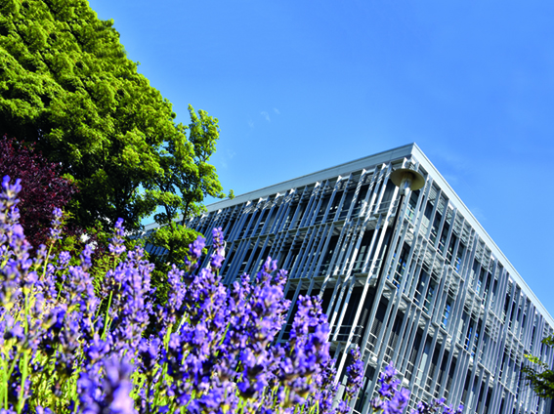

Dietary carbohydrate breakdown by the human human microbiota
Petra Louis

Slide 2

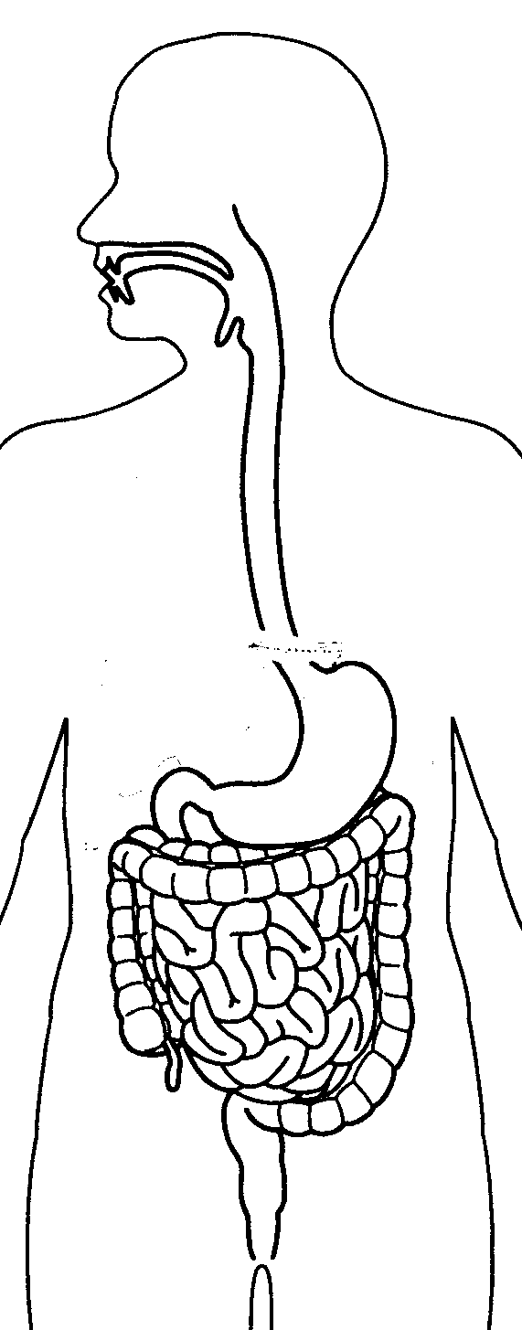
The human gut microbiota
Dense microbial community, particularly in the colon
Bacteria (few dominant phyla), Archaea, viruses, Eukaryotes
gastrointestinalmicrobes /ml:
Bacteroidetes
~20-30% of total faecal bacteria
Actinobacteria
oral cavity:
~1 Billion
Firmicutes
~60-70% of total faecal bacteria
Skin:
~ 1 Million /cm²
Proteobacteria
Stomach &
duodenum:
~10-1000
16S rRNA-based phylogenetic
tree of domain bacteria
High diversity at the levels of strains, species and genera present, particularly within Firmicutes and Bacteroidetes
jejunum & ileum:
~0.01-100 Million
Schematic representation of diversity of the faecal microbiota of an individual
colon:
~10-100 Billion
Adapted from Bäckhed et al., Science (2005) & Ley et al., Cell (2006)

Slide 3
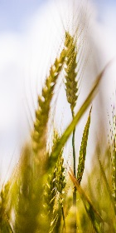
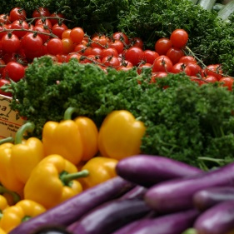
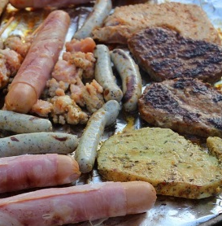
The human gut microbiota and diet
diet
carbohydrates
phyto-
chemicals
protein
& fat
structural
poly-
saccharides
Non-digestible
oligo-
saccharides
starch,
sugars
small
intestine
large
intestine
bile
mucus
microbial activity → metabolites
e.g. vitamins, short-chain fatty acids, phytochemicals, secondary bile acids
host
circulation

Slide 4
dietary non-digestible carbohydrates
Many different types of carbohydrates
→ different monosaccharide constituents
→ different linkages
→ linear or branched
→ non-sugar constituents
feruloylated arabinoxylan
cereal cell walls,
e.g. wheat
inulin-type fructan
storage carbohydrate,
e.g. onion, chicory
O
O
CH₂OH
O
OH
O
OH
O
OH
O
OH
O
O
OH
O
CH₂OH
OH
OH
HOH₂C
O
resistant starch
storage carbohydrate,
e.g. potato, rice, maize
OH
O
O
HO
OH
O
O
O
CH₂
OH
HOH₂C
OH
O
CH₂
CH₂OH
CH₂OH
O
HO
O
O
O
OH
OH
OH
OH
OCH₃
CH₂
O
O
O
O
OH
O
OH
OH
OH
CH₂OH
OH
O
galactomannan
storage carbohydrate in plant seeds,
e.g. locust bean
OH
O
OH
CH₂OH
CH₂
CH₂OH
O
O
O
O
OH
HO
O
OH
HO
O
OH
HO
O

Slide 5
Microbial carbohydrate metabolism
non-digestible carbohydrates
soluble
insoluble
breakdown dependent on keystone species
soluble

Slide 6
Microbial carbohydrate metabolism – resistant starch
non-digestible carbohydrates
proportion of starch remaining undigested in the upper gut → colon;
due to its physicochemical properties
soluble
insoluble
resistant starch
breakdown dependent on keystone species
Ruminococcus bromii
soluble
α-glucans, glucose
Bacteroides spp.
Eubacterium rectale
etc., etc., etc.

Slide 7
Microbial carbohydrate metabolism – resistant starch
non-digestible carbohydrates
Human dietary intervention trial
Controlled resistant starch intakes
Faecal microbiota composition →
increase in Ruminococcus spp.
soluble
insoluble
resistant starch
breakdown dependent on keystone species
Ruminococcus bromii
soluble
α-glucans, glucose
Bacteroides spp.
Eubacterium rectale
etc., etc., etc.
Cluster IV Ruminococcus spp. - qPCR
80
M RS NSP WL
80
M NSP RS WL
70
Volunteer
70
Volunteer
60
14
60
11
15
12
50
16
50
17
20
18
% of total 16S rRNA gene copies
22
40
19
40
25
23
30
26
30
24
20
20
10
10
0
0
10
20
30
40
50
60
70
0
0
10
20
30
40
50
60
70
time [days]
time [days]
Walker et al. ISME J (2011)

Slide 8
Microbial carbohydrate metabolism – resistant starch
non-digestible carbohydrates
Human dietary intervention trial
Controlled resistant starch intakes
Faecal microbiota composition →
increase in Ruminococcus spp.
Determination of undigested starch based on dietary intake and starch excreted in faeces
soluble
insoluble
resistant starch
breakdown dependent on keystone species
Ruminococcus bromii
soluble
α-glucans, glucose
Bacteroides spp.
Eubacterium rectale
etc., etc., etc.
Cluster IV Ruminococcus spp. - qPCR
Residual starch excreted in faeces
Volunteers without detectable
levels of R. bromii
80
M RS NSP WL
70
100
Volunteer
60
14
80
RS diet
15
NSP diet
50
16
20
60
% of total 16S rRNA gene copies
22
40
25
% residual faecal starch
30
26
40
20
20
10
0
0
10
20
30
40
50
60
70
0
11
12
17
18
19
23
24
14
15
16
20
22
25
26
time [days]
volunteer
Walker et al. ISME J (2011)

Slide 9
Microbial carbohydrate metabolism – resistant starch
non-digestible carbohydrates
In vitro assessment of resistant starch degradation in volunteer 25
poor starch fermentability
addition of single known starch-degrading bacteria
only R. bromii restores starch breakdown
soluble
insoluble
resistant starch
breakdown dependent on keystone species
Ruminococcus bromii
soluble
α-glucans, glucose
Bacteroides spp.
Eubacterium rectale
etc., etc., etc.
Volunteer 25 in vitro
faecal starch utilisation
Residual starch excreted in faeces
Volunteers without detectable
levels of R. bromii
100
100
80
80
RS diet
V25 faecal sample
NSP diet
60
+ B. adolescentis
60
% of residual starch
+ E. rectale
40
+ B. thetaiotaomicron
% residual faecal starch
40
20
+ R. bromii
20
0
0
0
10
20
30
40
50
11
12
17
18
19
23
24
14
15
16
20
22
25
26
Time [h]
volunteer
Ze et al. ISME J (2012)
Walker et al. ISME J (2011)

Slide 10
Microbial carbohydrate metabolism – resistant starch
non-digestible carbohydrates
What distinguishes keystone species from other carbohydrate-degraders?
soluble
insoluble
resistant starch
breakdown dependent on keystone species
Ruminococcus bromii
soluble
α-glucans, glucose
Bacteroides spp.
Eubacterium rectale
etc., etc., etc.

Slide 11
Microbial carbohydrate metabolism – resistant starch
non-digestible carbohydrates
What distinguishes keystone species from other carbohydrate-degraders?
Can be difficult to establish based on sequence information alone:
amylase gene carriage in genomes of
R. bromii and other bacteria is similar
organisation of enzymes
soluble
insoluble
resistant starch
breakdown dependent on keystone species
Ruminococcus bromii
soluble
α-glucans, glucose
Bacteroides spp.
Eubacterium rectale
etc., etc., etc.
Carriage of glycoside hydrolases related
to starch breakdown
R. bromii amylosome
dockerin
cohesion
Sca: scaffoldin
B. xylanis. XB1A
E. rectale M104/1
R. bromii L2-63
B. theta. VPI-5482
R. intestinalis M50/1
B. adol. ATCC 15703
R. intestinalis XB6B4
E. rectale ATCC 33656
information from CAZy database (www.cazy.org)
Ze et al. mBio (2015); Mukhopadhya et al. Environ Microbiol (2018)

Slide 12
Microbial carbohydrate metabolism – Ruminococcaceae multienzyme complexes
Selected glycoside hydrolase families encoded by genomes
R. bicirculans 80/3
R. champanellensis 18P13
R. flavefaciens FD1 (rumen)
R. bromii L2-63
courtesy of Harry Flint
R. champanellensis cellulosome
R. bromii amylosome
dockerin
cohesion
Sca: scaffoldin
Ben David et al. Env Micro (2015)
Ze et al. mBio (2015); Mukhopadhya et al. Environ Microbiol (2017)

Slide 13
Microbial metabolic network
indigestible polysaccharides
& oligosaccharides
fibre degraders
monosaccharides
fermentative bacteria
H₂ CO₂/formate lactate succinate ethanol
SO₄²⁻
sulfate reducers
methanogens
acetogens
H₂S
CH₄
ACETATE BUTYRATE PROPIONATE
Short-chain fatty acids (SCFA)

Slide 14
Short-chain fatty acids (SCFA)
>90% of SCFA absorbed by the host
acetate → muscle & organs
propionate → liver
butyrate → gut epithelium
Dietary fibre
(non-digestible carbohydrates)
Local effects:
gut barrier
gut motility & transit
anti-carcinogenic, anti-inflammatory
lowering of pH
mineral absorption
microbial SCFA production:
acetate, propionate, butyrate
CH₃─COO⁻
CH₃─CH₂─COO⁻
Systemic effects:
appetite regulation
glucose and lipid metabolism
energy supply
regulation of energy expenditure?
CH₃─CH₂─CH₂─COO⁻

Slide 15
Faecal microbiota incubations
pyrodextrin
pullulan
type II RS
type III RS
barley β-glucan
laminarin
rhamnose
rhamnogalacturonan
apple pectin
carob galactomannan
guar galactomannan
arabinoxylan
oligofructose
medium-chain inulin
long-chain inulin
no substrate control
Faecal in vitro incubations
anaerobic conditions
3 donors
pH representing proximal and distal colon: 5.5 & 6.5
SCFA
Microbiota composition:
qPCR, sequencing
Repeat of the experiment for 4 carbohydrates
approx. one year later
3 donors (two = first year)
→ SCFA, qPCR
α-glucans
β-glucans
pectin-type
galactomannans
fructans
Reichardt et al. ISME J (2018)

Slide 16
Faecal microbiota incubations – SCFA production (average data)
A
other
butyrate
propionate
acetate
pH 5.5
α-/β-glucans
fructans
*
*
*
*
*
*
*
*
*
*
*
*
*
*
*
*
*
*
*
Short-chain fatty acid production
after 24 h incubation [mM]
B
rhamnose
pH 6.5
*
*
*
*
*
*
*
*
*
*
*
*
*
*
*
*
*
*
*
*
*
*
Significance relative to no substrate control *P<0.001
Reichardt et al. ISME J (2018)

Slide 17
Faecal microbiota incubations – microbiota changes (qPCR, average data)
bacterial group or species:
†not detected in all volunteers
Bifidobacterium spp.
Bacteroides spp.
R. flavefaciens gr.
B. catenulatum gr.†
F. prausnitzii
R. inulinivorans
B. adolescentis
Oscillibacter gr.
Negativicutes
R. albus gr.†
Roseburia gr.
Blautia spp.
C. eutactus†
B. bifidum†
R. bromii
A. hadrus
Dorea spp.
E. eligens†
B. longum
NDC
f
E. hallii
pH 5.5 | Pyrodextrin | 1 | 0.9 | 1.5 | 1.2 | 0.7 | 1.1 | 0.5 | 1.6 | 1.0 | 0.8 | 1.4 | 1.7 | 0.7 | 1.2 | 0.7 | 0.8 | 1.5 | 1.2 | 1.0 | 1.9 | 3.4
 | Pullulan | 1 | 0.6 | 1.9 | 3.0 | 0.7 | 0.7 | 0.3 | 3.1 | 1.6 | 1.3 | 2.1 | 1.8 | 0.8 | 4.3 | 0.5 | 0.9 | 3.5 | 5.7 | 4.5 | 1.9 | 2.4
 | Type II RS | 1 | 0.8 | 1.9 | 12.8 | 1.1 | 1.1 | 0.5 | 3.6 | 1.3 | 2.1 | 2.5 | 1.8 | 1.1 | 5.5 | 0.7 | 1.0 | 8.3 | 14.9 | 3.4 | 7.3 | 3.8
 | Type III RS | 1 | 0.8 | 2.5 | 13.8 | 1.1 | 1.1 | 0.4 | 2.6 | 1.5 | 1.6 | 1.3 | 1.2 | 1.2 | 3.2 | 0.8 | 0.8 | 3.5 | 6.7 | 1.7 | 2.8 | 2.6
 | ß-Glucan | 1 | 0.6 | 2.5 | 1.2 | 0.8 | 1.5 | 0.3 | 2.4 | 2.0 | 1.4 | 3.3 | 4.2 | 0.8 | 18.4 | 0.6 | 1.1 | 1.2 | 0.8 | 0.8 | 1.6 | 2.9
 | ß-Glucan | 2 | 1.6 | 2.2 | 1.5 | nd | 0.6 | 0.6 | 5.7 | 2.7 | 1.7 | 2.2 | 2.6 | 0.7 | 10.6 | 0.5 | 0.7 | 3.1 | 3.0 | 2.3 | 2.8 | 1.1
 | Laminarin | 1 | 1.2 | 1.6 | 1.6 | 1.2 | 0.7 | 0.7 | 1.6 | 2.3 | 1.7 | 2.1 | 1.3 | 2.3 | 2.0 | 0.6 | 0.8 | 0.7 | 0.8 | 0.8 | 1.0 | 2.6
 | Rhamnose | 1 | 1.0 | 1.2 | 1.2 | 1.2 | 0.9 | 0.4 | 1.3 | 1.5 | 3.2 | 0.7 | 5.7 | 0.6 | 2.3 | 0.6 | 0.7 | 0.7 | 0.6 | 0.8 | 1.0 | 2.2
 | Rhamnose | 2 | 1.7 | 1.0 | 1.3 | nd | 0.3 | 0.8 | 1.1 | 1.1 | 12.8 | 0.6 | 13.3 | 0.8 | 2.0 | 0.4 | 0.4 | 1.1 | 1.1 | 1.0 | 1.0 | 0.9
 | Rhamnogal.ur. | 1 | 1.5 | 2.9 | 1.2 | 0.8 | 1.2 | 0.5 | 1.5 | 0.9 | 2.6 | 1.0 | 1.4 | 1.1 | 1.1 | 1.5 | 0.6 | 1.0 | 1.1 | 1.2 | 1.5 | 3.6
 | Apple Pectin | 1 | 0.9 | 3.4 | 2.3 | 0.7 | 0.9 | 0.4 | 1.4 | 1.2 | 1.5 | 1.9 | 1.3 | 1.1 | 2.7 | 1.5 | 1.1 | 2.0 | 2.1 | 1.9 | 2.6 | 5.3
 | Apple Pectin | 2 | 1.3 | 2.8 | 1.4 | nd | 0.3 | 1.1 | 1.2 | 1.2 | 2.8 | 0.9 | 1.6 | 1.6 | 1.4 | 1.7 | 0.5 | 2.3 | 2.2 | 1.6 | 1.9 | 1.4
 | Carob gal.man. | 1 | 0.4 | 0.8 | 0.4 | 0.7 | 0.3 | 0.1 | 0.9 | 0.5 | 0.4 | 0.4 | 0.5 | 0.5 | 12.8 | 0.2 | 0.3 | 0.5 | 0.3 | 0.2 | 1.2 | 2.2
 | Guar gal.man. | 1 | 1.2 | 1.2 | 1.7 | 4.6 | 0.7 | 0.8 | 1.8 | 1.1 | 0.7 | 0.6 | 1.4 | 1.7 | 3.7 | 0.6 | 0.7 | 0.7 | 0.7 | 0.7 | 0.8 | 1.9
 | Arabinoxylan | 1 | 0.6 | 0.9 | 1.2 | 0.8 | 0.9 | 0.3 | 1.8 | 1.4 | 1.1 | 2.6 | 1.2 | 0.7 | 1.9 | 0.5 | 0.7 | 5.3 | 5.5 | 12.0 | 4.5 | 2.9
 | Oligofructose | 1 | 0.8 | 1.8 | 4.4 | 1.0 | 1.3 | 0.5 | 3.5 | 1.6 | 2.4 | 4.7 | 1.9 | 1.7 | 4.1 | 0.7 | 1.2 | 7.0 | 8.0 | 5.5 | 7.3 | 11.5
 | MC Inulin | 1 | 0.5 | 2.4 | 4.2 | 0.6 | 1.2 | 0.3 | 4.2 | 1.6 | 1.8 | 5.2 | 2.2 | 1.2 | 4.2 | 0.5 | 1.2 | 1.7 | 1.8 | 1.6 | 2.2 | 6.7
 | LC Inulin | 1 | 0.5 | 2.2 | 4.2 | 0.7 | 1.0 | 0.2 | 3.7 | 1.4 | 1.8 | 5.2 | 2.8 | 1.2 | 4.7 | 0.5 | 0.9 | 1.5 | 1.5 | 1.4 | 1.9 | 5.9
 | LC Inulin | 2 | 0.9 | 1.9 | 2.3 | 1.1 | 1.3 | 0.3 | 3.5 | 1.1 | 1.5 | 7.4 | 3.1 | 0.8 | 2.7 | 0.4 | 0.5 | 5.3 | 5.3 | 2.0 | 1.5 | 2.1
pH 6.5 | Pyrodextrin | 1 | 2.2 | 0.3 | 0.5 | 0.8 | 0.2 | 0.4 | 1.1 | 0.6 | 0.1 | 0.1 | 0.2 | 1.4 | 1.0 | 0.4 | 0.3 | 0.1 | 0.1 | 0.7 | 0.1 | nd
 | Pullulan | 1 | 2.1 | 1.2 | 1.8 | 1.3 | 0.8 | 0.3 | 2.4 | 1.2 | 2.0 | 1.2 | 1.6 | 1.0 | 2.7 | 0.8 | 1.2 | 2.1 | 8.3 | 2.5 | 0.0 | 0.8
 | Type II RS | 1 | 1.0 | 1.4 | 6.3 | 1.0 | 0.9 | 0.4 | 4.1 | 1.9 | 2.3 | 1.3 | 2.3 | 1.2 | 1.0 | 0.6 | 0.6 | 3.6 | 4.6 | 1.7 | 4.7 | 0.9
 | Type III RS | 1 | 1.2 | 0.7 | 7.0 | 0.9 | 0.3 | 0.5 | 2.0 | 0.9 | 0.4 | 0.2 | 0.3 | 1.1 | 2.1 | 0.4 | 0.3 | 0.4 | 0.6 | 0.6 | 0.1 | 0.0
 | ß-Glucan | 1 | 1.5 | 0.7 | 0.4 | 1.2 | 0.5 | 0.3 | 3.2 | 3.2 | 0.3 | 0.3 | 0.5 | 0.7 | 9.8 | 0.4 | 0.4 | 0.2 | 0.1 | 0.4 | 0.1 | nd
 | ß-Glucan | 2 | 2.6 | 2.2 | 0.9 | nd | 0.3 | 0.8 | 4.6 | 4.5 | 3.2 | 1.7 | 1.8 | 0.8 | 9.5 | 0.7 | 1.2 | 2.5 | 2.5 | 2.4 | 1.8 | 1.1
 | Laminarin | 1 | 2.8 | 1.0 | 1.0 | 0.9 | 0.8 | 0.5 | 1.0 | 9.0 | 1.9 | 1.2 | 1.5 | 1.3 | 0.8 | 0.6 | 1.8 | 1.2 | 0.8 | 1.7 | 1.1 | 0.7
 | Rhamnose | 1 | 1.6 | 0.6 | 0.4 | 0.9 | 0.3 | 0.3 | 0.7 | 0.6 | 0.8 | 0.2 | 0.7 | 0.2 | 1.5 | 0.3 | 0.3 | 0.2 | 0.2 | 0.4 | 0.1 | 0.0
 | Rhamnose | 2 | 1.5 | 1.3 | 2.0 | nd | 0.3 | 1.2 | 1.0 | 0.9 | 17.9 | 0.8 | 12.4 | 1.0 | 0.9 | 0.8 | 0.7 | 1.4 | 1.3 | 1.1 | 1.0 | 0.8
 | Rhamnogal.ur. | 1 | 2.6 | 0.7 | 0.3 | 0.7 | 0.2 | 0.7 | 0.5 | 0.6 | 0.5 | 0.2 | 0.2 | 1.2 | 1.4 | 4.1 | 0.4 | 0.1 | 0.1 | 0.5 | 0.2 | nd
 | Apple Pectin | 1 | 1.2 | 1.9 | 0.9 | 0.9 | 0.9 | 0.5 | 1.1 | 1.1 | 1.7 | 1.1 | 1.5 | 1.2 | 0.9 | 2.7 | 0.8 | 1.6 | 1.4 | 1.4 | 1.5 | 1.7
 | Apple Pectin | 2 | 1.7 | 5.9 | 1.3 | nd | 0.1 | 1.5 | 1.2 | 0.9 | 7.4 | 1.0 | 1.5 | 1.5 | 1.1 | 1.9 | 0.7 | 2.4 | 2.3 | 1.9 | 1.7 | 1.3
 | Carob gal.man. | 1 | 1.6 | 0.6 | 0.5 | 1.3 | 0.3 | 0.3 | 1.5 | 0.7 | 0.3 | 0.4 | 0.4 | 1.0 | 5.4 | 0.3 | 0.6 | 0.4 | 0.4 | 0.9 | 0.3 | nd
 | Guar gal.man. | 1 | 2.2 | 1.0 | 1.0 | 2.2 | 0.6 | 0.5 | 2.5 | 0.8 | 1.0 | 0.9 | 1.3 | 1.0 | 4.7 | 0.7 | 1.4 | 0.4 | 1.0 | 1.8 | 0.8 | 0.9
 | Arabinoxylan | 1 | 1.2 | 0.3 | 0.3 | 0.7 | 0.1 | 0.3 | 5.0 | 1.2 | 0.2 | 0.7 | 0.2 | 1.4 | 1.3 | 0.3 | 0.5 | 0.2 | 0.1 | 1.7 | 0.6 | nd
 | Oligofructose | 1 | 1.4 | 1.7 | 1.8 | 1.5 | 1.1 | 0.4 | 2.4 | 1.2 | 3.7 | 2.5 | 2.2 | 1.5 | 2.2 | 0.9 | 1.0 | 2.8 | 9.1 | 3.2 | 8.0 | 3.0
 | MC Inulin | 1 | 1.3 | 1.9 | 1.6 | 1.3 | 1.3 | 0.4 | 3.1 | 1.3 | 2.9 | 2.6 | 2.8 | 1.4 | 2.6 | 0.8 | 1.2 | 1.6 | 7.0 | 2.3 | 0.1 | 2.8
 | LC Inulin | 1 | 1.0 | 1.1 | 0.8 | 1.3 | 0.4 | 0.3 | 2.1 | 1.1 | 0.4 | 0.8 | 0.7 | 1.3 | 2.2 | 0.4 | 0.5 | 0.6 | 1.1 | 0.9 | 0.1 | nd
 | LC Inulin | 2 | 1.6 | 3.1 | 1.4 | nd | 1.1 | 0.8 | 2.1 | 0.9 | 4.3 | 3.1 | 3.3 | 1.0 | 1.0 | 0.6 | 1.2 | 5.8 | 4.9 | 2.3 | 1.1 | 1.5
Some shared responses across donors,
eg. R. bromii on resistant starch
A. hadrus on inulin
fold-
change:
≤1
>1
>2.5
>5
>10
Significance relative to no substrate control (P<0.001)
Reichardt et al. ISME J (2018)

Slide 18
Faecal microbiota incubations – microbiota changes (sequencing, individual data)
Propionate
Propionate %
180 Bacteroides fragilis (100%)
177 Alistipes timonensis (97%)
163 Bacteroides finegoldii (99%)
162 Bacteroides caccae (99%)
152 Bacteroides fluxus (100%)
146 Alistipes senegalensis (99%)
120 Roseburia inulinivorans (98%) (Pdu)
119 Ruminococcus torques (100%) (Pdu)
118 Flavonifractor plautii (99%) (Pdu)
107 Eubacterium biforme (97%)
101 Ruminococcus obeum (97%) (Pdu)
100 Roseburia inulinivorans (98%) (Pdu)
99 Odoribacter splanchnicus (99%)
96 Clostridium lactatifermentans (99%) (Acr)
89 Blautia producta (100%) (Pdu)
81 Blautia producta (97%) (Pdu)
76 Blautia hydrogenotrophica (100%) (Pdu)
70 Bacteroides xylanisolvens (100%)
57 Alistipes finegoldii (100%)
53 Ruminococcus gnavus (97%) (Pdu)
52 Barnesiella intestinihominis (99%)
51 Phascolarctobacterium succinatutens (100%)
45 Bacteroides ovatus (100%)*
42 Alistipes putredinis (100%)
39 Alistipes shahii (99%)
38 Bacteroides intestinalis (100%)
29 Bacteroides stercoris (99%)
28 Phascolarctobacterium faecium (100%)
27 Bacteroides thetaiotaomicron (99%)*
26 Parabacteroides merdae (98%)*
25 Akkermansia muciniphila (99%)
20 Alistipes onderdonkii (100%)
15 Bacteroides dorei (99%)
14 Eubacterium hallii (99%) (Pdu)
6 Blautia faecis (99%) (Pdu)*
5 Bacteroides uniformis (100%)*
4 Bacteroides vulgatus (99%)
1 Ruminococcus obeum (98%) (Pdu)
propionate-producing species
(operational taxonomic units at 97% sequence identity)
donor 1
donor 2
donor 3
pH 5.5
pH 6.5
pH 5.5
pH 6.5
pH 5.5
pH 6.5
Py
RSII
RSIII
BG
La
Rh
RG
AP
Ca
Gu
AX
OF
I-HP
Py
Pu
RSII
RSIII
BG
La
Rh
RG
AP
Ca
Gu
AX
OF
I-GP
I-HP
no
i
Py
Pu
RSIII
BG
Rh
RG
Ca
Gu
AX
I-GP
I-HP
Py
Pu
RSII
RSIII
BG
La
Rh
RG
AP
Ca
Gu
AX
OF
I-GP
I-HP
no
i
Py
Pu
RSII
RSIII
BG
La
Rh
RG
AP
Ca
Gu
AX
OF
I-GP
I-HP
no
RSII
RSIII
BG
La
Rh
AP
Ca
Gu
OF
I-GP
I-HP
no
i
Some shared responses across donors,
eg. R. bromii on resistant starch
A. hadrus on inulin
many donor-specific responses
Butyrate
donor 1
Py
RSII
RSIII
BG
La
Rh
RG
AP
Ca
Gu
AX
OF
I-HP
Py
Pu
RSII
RSIII
BG
La
Rh
RG
AP
Ca
Gu
AX
OF
I-GP
I-HP
no
i
Py
Pu
RSIII
BG
Rh
RG
Ca
Gu
AX
I-GP
I-HP
Py
Pu
RSII
RSIII
BG
La
Rh
RG
AP
Ca
Gu
AX
OF
I-GP
I-HP
no
i
Py
Pu
RSII
RSIII
BG
La
Rh
RG
AP
Ca
Gu
AX
OF
I-GP
I-HP
no
RSII
RSIII
BG
La
Rh
AP
Ca
Gu
OF
I-GP
I-HP
no
i
Butyrate %
171 Clostridium symbiosum (99%)
139 Anaerostipes hadrus (97%)
137 Coprococcus eutactus (99%)
134 Coprococcus comes (99%)
127 Clostridium clostridioforme (100%)
120 Roseburia inulinivorans (98%)
118 Flavonifractor plautii (99%)
107 Eubacterium biforme (97%)
100 Roseburia inulinivorans (98%)
99 Odoribacter splanchnicus (99%)
88 Roseburia intestinalis (98%)
85 Eubacterium ramulus (99%)
79 Anaerostipes hadrus (98%)
77 Clostridium polysaccharolyticum (97%)
43 Eubacterium ventriosum (98%)*
40 Roseburia hominis (99%)
35 Butyrivibrio crossotus (100%)
34 Acidaminococcus intestini (100%)
21 Faecalibacterium prausnitzii (99%)
14 Eubacterium hallii (99%)
13 Subdoligranulum variabile (99%)*
8 Anaerostipes hadrus (100%)
7 Eubacterium rectale (100%)
2 Faecalibacterium prausnitzii (99%)*
butyrate-producing species
(operational taxonomic units at 97% sequence identity)
donor 2
donor 3
pH 5.5
pH 6.5
pH 5.5
pH 6.5
pH 5.5
pH 6.5
Reichardt et al. ISME J (2018)

Slide 19
Faecal microbiota incubations – propionate and butyrate production
+ pH 5.5, Δ pH 6.5
P(pH) = 0.75
P(Prop. prod.) < 0.001
P(pH x Prop. prod.) = 0.75
P(pH) < 0.001
P(But. prod.) < 0.001
P(pH x But. prod.) = 0.063
Propionate [%]
Butyrate [%]
Propionate producers [%]
Butyrate producers [%]
strong correlation between sum of all propionate- or butyrate-producing OTUs vs propionate
or butyrate production → functional redundancy
pH-dependent for butyrate production – may reflect shifts in relative production of different fermentation products (Kettle et al Environ Microbiol 2015; Louis & Flint Environ Microbiol 2017)
Reichardt et al. ISME J (2018)

Slide 20
Faecal microbiota carbohydrate metabolism and SCFA formation
Evidence from
single strain characterisation
faecal incubations
in vivo studies
R. bromii
Roseburia spp.
Bacteroides spp.
F. saccharivorans
D. longicatena
E. ventriosum
Bacteroides spp.
F. prausnitzii
E. hallii
C. bolteae
Roseburia spp.
Blautia spp.
Bacteroides spp.
C. eutactus
F. saccharivorans
E. ventriosum
Roseburia spp.
Bifidobacterium spp.
S. variabile
arabinoxylan
pectins
Bacteroides spp.
C. eutactus
F. prausnitzii
F. saccharivorans
D. longicatena
P. merdae
Roseburia spp.
A. hadrus
D. longicatena
α-glucans
β-glucans
fructans
galactomannans
pyruvate
Bifidobacterium spp.
Blautia spp.
E. hallii
fructans
lactate
E. hallii
A. hadrus
1,2-propanediol
rhamnose
oxalo-
acetate
Blautia spp.
Bacteroides spp.
arabinoxylan
Bifidobacterium spp.
acetate
acetyl-CoA
Bacteroides spp.
Veillonella spp.
α-glucans
succinate
Blautia spp.
Roseburia inulinivorans
E. hallii
Dialister,
Phascolarcto-
bacterium
butyryl-CoA
acetyl-CoA
propionate
Roseburia spp.
Anaerostipes spp.
F. prausnitzii
E. hallii
C. catus
butyryl-P
C. eutactus
C. comes
butyrate
modified from Reichardt et al. ISME J (2018)

Slide 21
Modelling microbiota metabolism
NSP starch protein
oligosaccharides, sugars
  Dietary substrates
B1, B3, B5, B6
B1-B9
B2, B5
B1
  Functional microbial groups
B1: Bacteroidetes (ac.-prop.-succ.)
B2: Non-butyrate-forming starch degraders
B3: Non-butyrate-forming fibre degraders
B4: Lactate producers (Actinobacteria)
B5: Butyrate producers 1 (Roseburia spp.)
B6: Butyrate producers 2 (F. prausnitzii)
B7: Propionate producers (Negativicutes)
B8: Butyrate producers 3, lactate utilisers
B9: Acetogens
B10: Methanogens
PEP
pyruvate
B4, B5, B6
lactate
H₂ +
CO₂
B8
formate
H₂ + CO₂
B1-B9
B1, B3
B7
acetyl CoA
succinate
B7
B10
B9
B2, B4
B1, B7
CH₄
acetate
B5, B6, B8
EtOH
propionate
  Metabolites
butyrate
Model based on:
Pathway stoichiometries of each pathway
Growth rate and yield on each substrate
pH tolerance for each microbial group
Adaptation: several strains within each group with different growth characteristic;
evolves over time; can model inter-individual variation
Kettle et al. Environ Microbiol (2015); Kettle et al Meth Ecol Evol (2018)

Slide 22
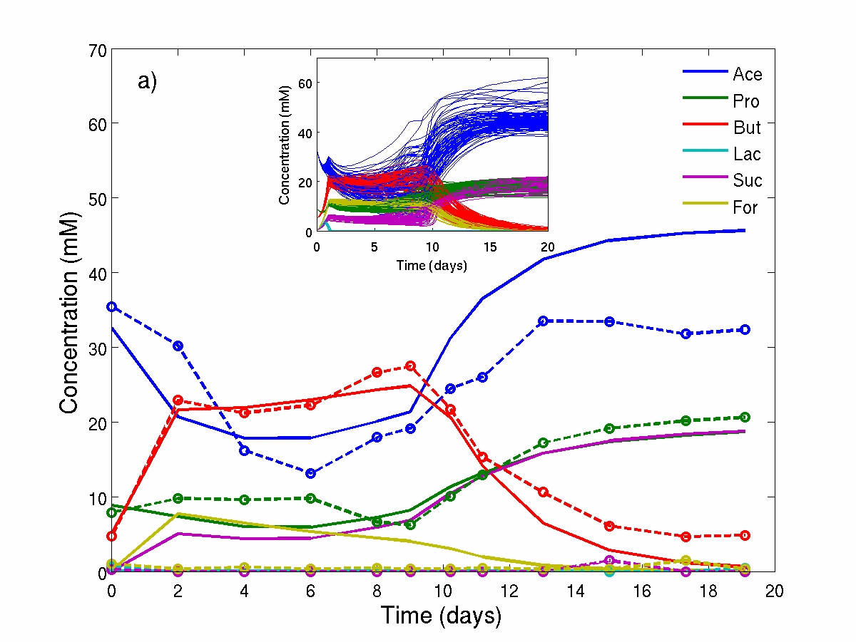
Modelling microbiota metabolism
NSP starch protein
Modelling of in vitro continuous flow fermentor study investigating pH response (Walker et al. AEM 2005)
fermentor data
model data
oligosaccharides, sugars
B1, B3, B5, B6
B1-B9
B2, B5
B1
PEP
pyruvate
B4, B5, B6
lactate
H₂ +
CO₂
B8
formate
H₂ + CO₂
B1-B9
B1, B3
B7
acetyl CoA
succinate
B7
B10
B9
B2, B4
B1, B7
CH₄
acetate
B5, B6, B8
EtOH
propionate
butyrate
Model based on:
Pathway stoichiometries of each pathway
Growth rate and yield on each substrate
pH tolerance for each microbial group
Adaptation: several strains within each group with different growth characteristic;
evolves over time; can model inter-individual variation
Kettle et al. Environ Microbiol (2015); Kettle et al Meth Ecol Evol (2018)

Slide 23

Microbial growth requirements and competitive fitness- vitamins
Roseburia intestinalis M50/1
1st passage
2nd passage
3rd passage
all vitamins
no biotin
no cobalamin
no folate or pABA
no folate
no niacin
no pantothenate
Roseburia faecis M72/1
no pyridoxine
no riboflavin
1st passage
2nd passage
3rd passage
no thiamine
no menaquinone
no vitamins

Slide 24
Microbial growth requirements and competitive fitness
[ThiS]-COPH
Roseburia intestinalis M50/1
[IscS]-SH
ThiF
3rd passage
L-cysteine
[ThiS]-CO-AMP
[IscS]-SSH
ThiI
[ThiS]-COSH
glycer-aldehyde-3P
pyruvate
L-tyrosine
L-glycine
Importance of confirming genome sequence-based data
annotation errors
genes missing in draft genomes
genes not functional or not expressed
dxs
ThiH
ThiO
1-deoxy-D-xylulose-5-phosphate
ThiG
L-glycine imine
2-(2-carboxy-4-methyl-thiazol-5-yl)ethyl phosphate
Roseburia faecis M72/1
ThiE
thiamine-P
3rd passage
4-amino-5-hydroxzymethyl-2-methylpyrimidine diphosphate
ThiD
4-amino-5-hydroxzymethyl-2-methylpyrimidine phosphate
ThiC
1-(phospho-ribosyl)-5-aminoimidazole

Slide 25
Conclusions
Keystone species seems to be important for effective metabolism of insoluble dietary carbohydrates
Microbiota profiling at species (and possibly strain) level is important as individual species can have specialised roles
e.g. Ruminococcus bromii – resistant starch breakdown
Inter-individual variation – functional redundancy vs personalised nutrition
Complex system → models → defined microbial consortia

Slide 26





Acknowledgements
Funding
Scottish
Government
Harry Flint
Sylvia Duncan
Alan Walker
Aurore Bergerat
Freda Farquharson
Jennifer Ince
Jenny Laverde
Nicole Reichardt
Paul Sheridan
Eva Soto-Martin
Maren Vollmer
Lucy Webster
Xiaolei Ze
David Brown
Janice Drew
Alex Johnstone
Gerald Lobley
Lynda Williams
Human Studies Unit
Grietje Holtrop
Helen Kettle
Collaborators:
Julian Parkhill et al. (Wellcome Trust Sanger Inst. Cambridge)
Ed Bayer et al. (Weizmann Inst. Israel)
Bernard Henrissat (Aix-Marseille University)
Nathalie Juge et al. (Institute of Food Research, Norwich)
Nicole Koropatkin (University of Michigan)
Mirko Bunzel et al. (Karlsruhe Institute of Technology)
Douglas Morrison et al. (University of Glasgow)
Muriel Derrien, Jean-Michel Faurie (Danone)

