Slide 1
Personalized Nutrition: Therapeutic Potential & Regulatory Challenges
Dr Manfred Ruthsatz
Global Head Regulatory Advocacy
Importance of Microbiota in Human Health International Conference
Warsaw, November 7, 2018

Slide 2
Nutrition in Health & Disease Management
➔ The Big Decisions to Prepare for our Future HealthCare
Food Fortification
«Varied & Balanced»
Dietary Guidelines
DRI, NRV, EAR, UL, …
(age/gender/pregnancy …)
NCD Prevention
Disease Related
Malnutrition Management
Nutrition Therapy, Enteral & Parenteral Nutrition
HealthCare Professionals
Rare («Orphan») Diseases
NCD-NRVs …
Dietary/Food Supplements
Microbiome & technologies («omics», apps, 3D …)
WIN-WIN-4 «Citizens»
Improved Consumer & Patient Care
Reduced Health Systems Costs
Population Based Nutrition
Elevate Role of Nutrition
Personalize Nutrition
K E Y I S S U E S & H U R D L E S
Improve Status Quo (WHO/NCDs:
Diabetes, Dementias, CVDs, Cancers, …)
Regulatory & HealthCare Frameworks: Technical Barriers, Implementation
(Multiple Stakeholders)
Regulatory, Science Technology, Media ➔ Health-Disease Continua; Speed
Ruthsatz – Warsaw, November 2018

Slide 3
Healthy Consumer ⬄ Patient «Continuum»
«Personalizing» the NUTRITION PYRAMID
I.V.
Nutrition (Drug)
General Food ➔ balanced & varied «normal» diet
(incl. Food Fortification, «Functional Food» (Health Claims))
Food Supplements (Health Claims)
Food for Specific Groups (FSG)
Food for Specific Dietary Uses (FSDU)
Links
Diet
(Epi-) Genes
Life-
style
Food for Special Medical Purposes
➔ Oral Nutritional Supplements / Tube Feeds
«Dietary Disease Management …»
➔ «Use Under Medical Supervision»
«omics», Gut Microbiome, 3D …
Health - Disease
Nutrients, Probiotics, Botanicals …
Disease - Health
Ruthsatz – Warsaw, November 2018

Slide 4
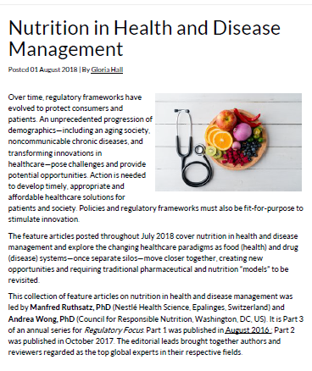
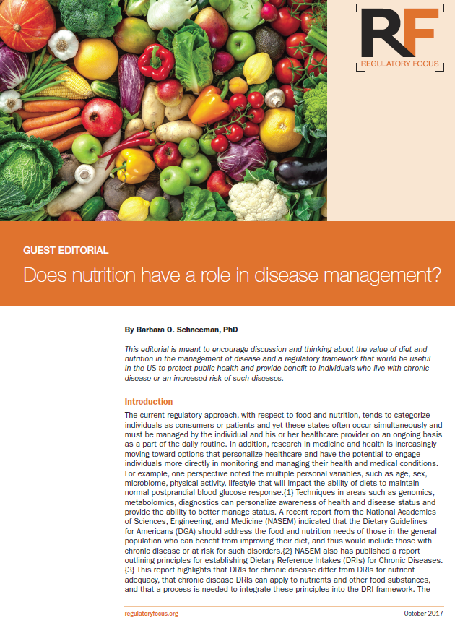

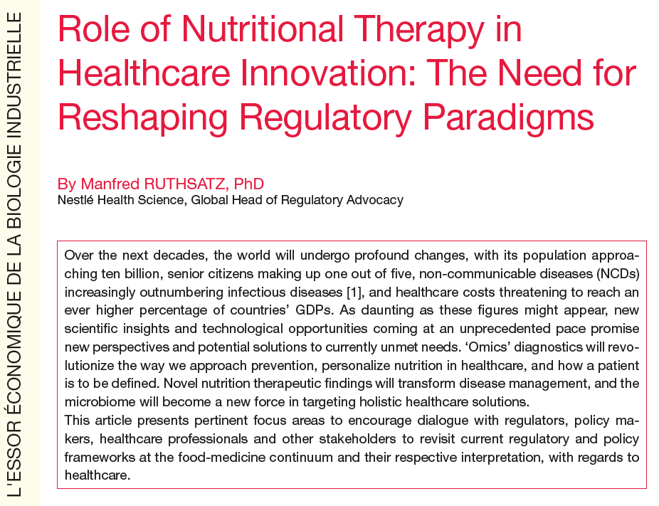
Annual Series in: «Regulatory Focus»
Personalized Nutrition: Therapeutic Potential & Regulatory Challenges
2017
  (Personalized/Targeted) Nutrition in Health & Disease Management
  Microbiome
Regulatory Challenges
2017
In: Annales des Mines (2017)
Ruthsatz – Warsaw, November 2018

Slide 5

Medical Nutrition: Improving Nutritional Status / Clinical Advantage
Can be a de-facto Disease Prevention/Management/Treatment - Complementing Drugs
 | Disease / Medical Condition | Clinical Benefit
Nutrition as Disease-related Malnutrition Management | Short Bowel Syndrome; Stroke | Lifesaving Intervention
 | COPD | Increased Ventilatory Capacity
 | Surgical Patients | Less Complications
 | Older patients | Increased Quality of Life, Decreased Morbidity/Mortality
Nutrition as Disease Management («Therapy») | Crohn’s Disease | Induction of Remission
 | Cow’s Milk Allergy | Reduced Symptoms, Catch-up Growth
 | IEMs: PKU, MSUD, FAOD, GSD … | Normal Growth & Development
 | Intractable Epilepsy | Less Seizures; Normal Growth & Development
Adapted from: http://www.eu-patient.eu/globalassets/press/pressreleases/2013-05-24_pr-nutrition_epf-egan-enha.pdf
Ruthsatz – Warsaw, November 2018
Notes:
some practical examples where medical nutrition can make a or the difference

Slide 6


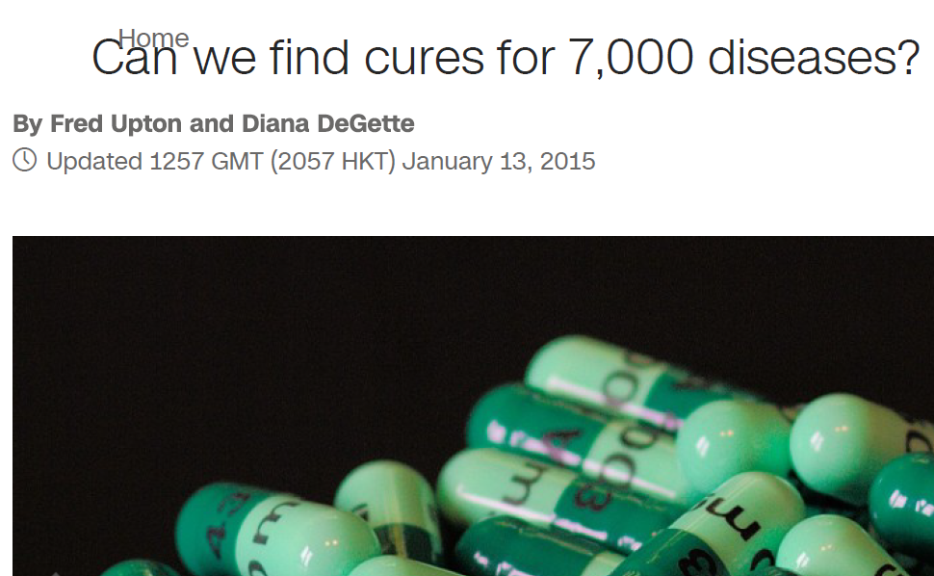
Rare Metabolic Disorders
& Specialized Nutrition
1960s
2004
Medical Condition | Amino Acid* | Incidence (est.)** | # (pa EU)**
Phenylketonuria (PKU) | Phe | 1:10,000 (EU); 1:2600 (TR) - 1:18,300 (IN) - 1:200,000 (FI) | 460
Tyrosinaemia | Tyr, Phe | 1:105,000 (TYR1, most common type) | 46-66
Maple Syrup Urine Disease (MSUD) | Leu, Ile, Val (BCAAs) | 1:180,000-250,000 (US; AT); 1:200 (Amish; Mennonites; Jewish) | 20
Homocystinuria | Met, Cys | 1:100,000 | 46
Organic acidemia | Met, Val, Thr, Ile | 1:85,000 | 164
Glutaric aciduria | Lys, Trp | 1:80,000 (US prevalence: 140) | 137
Galactosemia | [Lactose; Galactose] | 1:45,000 | 53-79
NEWBORN SCREENING ONTARIO (CANADA)
26 Diseases Tested ➔ 70% managed by Diet
Argininosuccinic Acid Lyase Deficiency (ASA)
Biotinidase Deficiency
Carnitine Uptake Defect (CUD) // Citrullinemia //
Cobalamin A & B Defects
Congenital Adrenal Hyperplasia (CAH)
Congenital Hypothyroidism (CH)
Critical Congenital Heart Disease (CCHD)
Cystic Fibrosis (CF) // Galactosemia // Glutaric Acidemia Type 1 (GA1)
Homocystinuria // Isovaleric Acidemia (IVA)
Long Chain 3-Hydroxyacyl-CoA Dehydrogenase Deficiency (LCHAD)
Maple Syrup Urine Disease (MSUD)
Medium Chain Acyl CoA Dehydrogenase Deficiency (MCADD)
Methylmalonic Acidemia (MMA)
Phenylketonuria (PKU) // Propionic Acidemia (PA)
Severe Combined Immune Deficiency (SCID)
Sickle Cell Disease (Hemoglobin SC) - (Hemoglobin SS) - (Sickle/Beta-Thalassemia)
Trifunctional Protein Deficiency (TFP) // Tyrosinemia Type 1
Very Long Chain Acyl CoA Dehydrogenase Deficiency (VLCAD)
Jeong. Public Health Genomics 2017;20:166–173
*Essential AAs: Phe, Val, Thr, Trp, Met, Leu, Ile, Lys, His // **Sources: Wikipedia; NIH; Diätverband, DE
Ruthsatz – Warsaw, November 2018

Slide 7
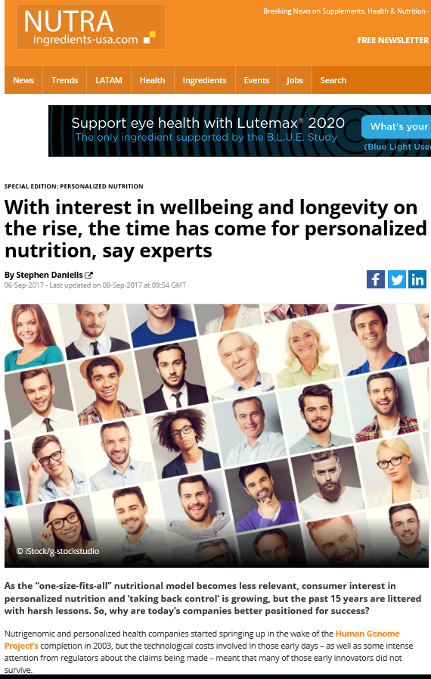
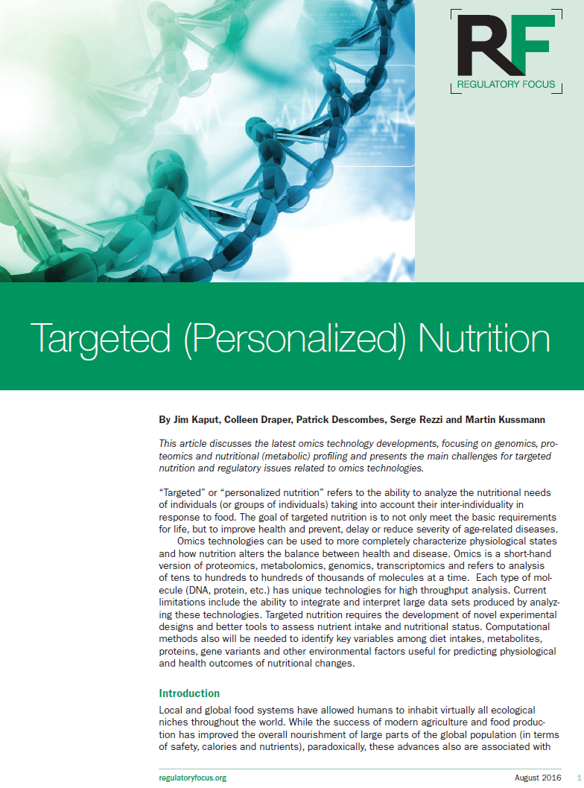
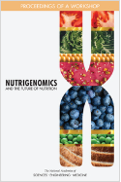
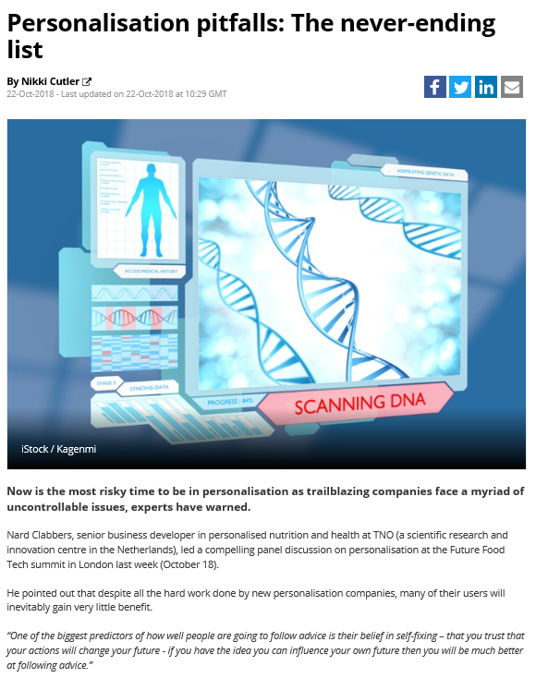
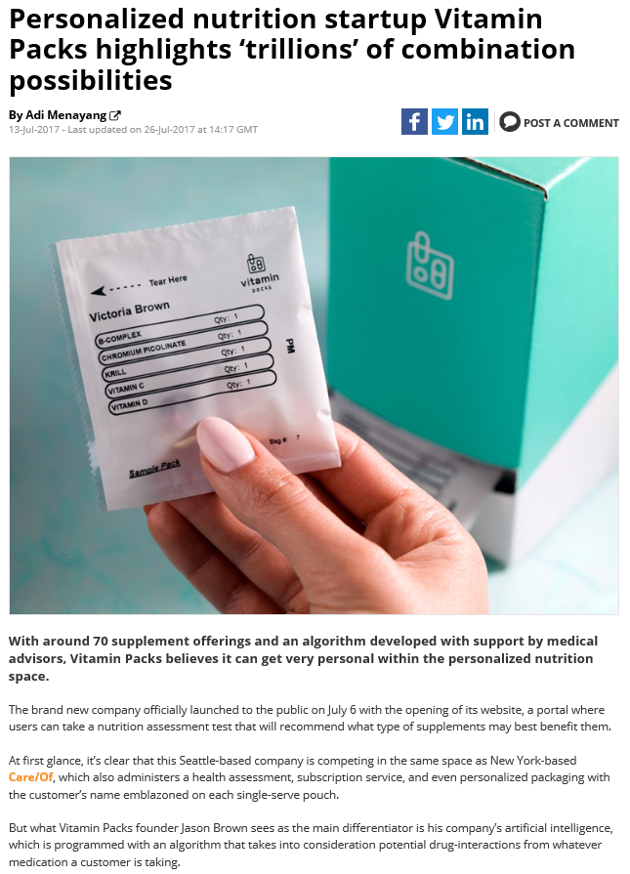
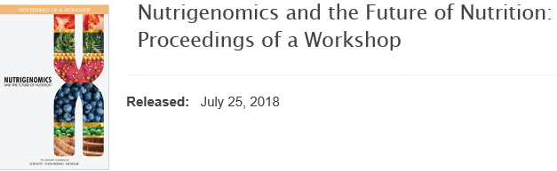

Personalized Nutrition – Reality & Complexity
2016
Ruthsatz – Warsaw, November 2018
J.Kaput (2016)

Slide 8
Nutraceuticals/Dietary/Health/Food Supplements (FS)
– Hype, Reality & Outlook ➔ «Personalization»!?
CORE DRIVERS
OFFICIAL RULES
& Qs
REALITY
Before mid-1930s: FS needed, yet not available
Since 1960s: FS (officially) not needed («balanced & varied diet»), yet consumed (EU/US: 30-80% adults)
Active & Healthy Aging; Well-being; Millennials; Non-Communicable Diseases (NCD), Prevention
Personalized Approaches: Curiosity («We want to know») (23andMe; Nutrigenomix ..)
Game Changing Diagnostics («omics»; apps; wearables; IVD …) ➔ Novel, Rapid, New Baseline, Regulatory «Convergence»
Multiple «CONTINUA» impact progress & regulatory frames:
➔ health-disease, food-medicine, consumer-patient (citizen)
US DSHEA 1994, EU FSD 2004; Codex 2005
FS part of «modifying normal diet»
(cf. FSMP/ medical food criteria: EU Commission 2017, EFSA 2015, US FDA guidelines 2016)
Post-Marketing Surveillance (US, EU …)
Social networks; cross-border & e-Commerce
Ruthsatz – Warsaw, November 2018

Slide 9
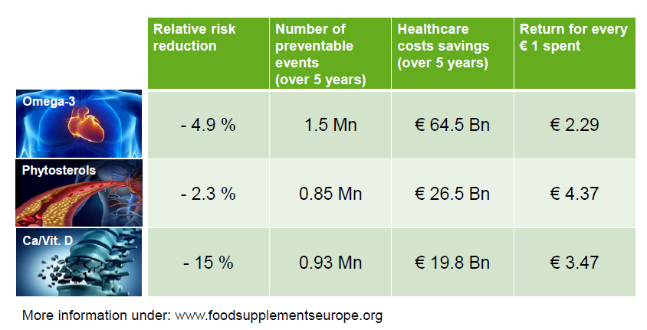
Personalized (Targeted) Nutrition – Opportunity & Risk
GET THE BASICS RIGHT! START WITH MEASURING
WHAT IS THE REAL ADVANTAGE? CITIZEN HEALTH
WHERE IS THE REAL RISK? LIMITED, YET QUESTIONS
Validated Diagnostics («omics; apps; wearables; …) to target reliable nutritional advice
Target micronutrient gaps (Vit.B12, Folic, D(winter!); Fe; Zn; …): elderly; vegetarians; ethnicities; …
Other nutrients: lactose, caffeine (CYP1A2/CVD), …
Beliefs vs. Facts! Adherence? Long-term effects? Safety? Overdosing? Complexity & Uncertainty?
Missing opportunity for low-risk solution to fill gaps
Science: critical for an effective regulation & policy, yet may not give all answers ➔ A demonstrated, perceived & sustained potential to improve consumer care, well-being & health systems is key
Science vs. «Bad Actors»! Social Media/Speed! Paying out-of-own-pocket
Preventable events & return for € spent (Ca/Vit.D; phytosterols; Omega-3 …)
Ruthsatz – Warsaw, November 2018

Slide 10
Personalized Nutrition: Therapeutic Potential & Regulatory Challenges
(Personalized/Targeted) Nutrition in Health & Disease Management
Microbiome
Regulatory Challenges
Ruthsatz – Warsaw, November 2018

Slide 11
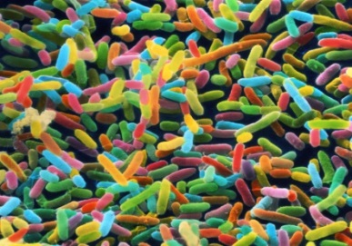
A Gut Microbiome Feeling
COMPLEX, ADAPTIVE ‘QUASI ORGAN’
VIEW CONTEXT
DON’T OVERSELL
Broad Role, not to be viewed in isolation
Blurred lines: good vs. bad over-simplified; only few strains seem important, 1 bacteria in a certain host environment & a genetic susceptibility can influence health or disease
Targeting the microbiome will not affect or cure all GI diseases
A variable in every aspect of host health
Diet has a strong effect on gut microbial composition
Oncology
CNS
GI
Derm
Ageing
Infectious Disease
Ruthsatz – Warsaw, November 2018

Slide 12
Microbiome Modulation & Deployment in Multiple Indications
We can influence by ….
... using Differentiating Technologies
Diagnosing the microbiome
How do we measure microbiota status in health & disease
Metagenomic ‘footprint’ of microbiota in health & disease
MetaHIT database (10 million bacterial genes)
De-risking CTs & development plans across indication areas
1
Replacing the Microbiome
Restore a healthy microbiome
Bacterial cultivation & spore technology
Access to unique bioinformatic tools to generate new Ecobiotics: defined live bacterial engraftments
2
Feed the healthy microbiome
Develop nutrients/molecules enhancing healthy microbiome
Developing nutrients/natural derived ingredients to modulate the microbiome (eg AAs, oligosaccharides, prebiotics, probiotics, lipids)
3
Kill the unhealthy microbiome
Develop targeted solutions & prevent colonisation of pathogens
Nutrients or bacteria derived small molecules
Antagonise attachment / metabolic activity of non-beneficial bacteria
4
Use bacteria as delivery system
Select & develop live bacteria as benefit delivery system
Unique delivery system (eg. L. lactis) for biologics & small molecules
Specific probiotics
5
12
Ruthsatz – Warsaw, November 2018

Slide 13
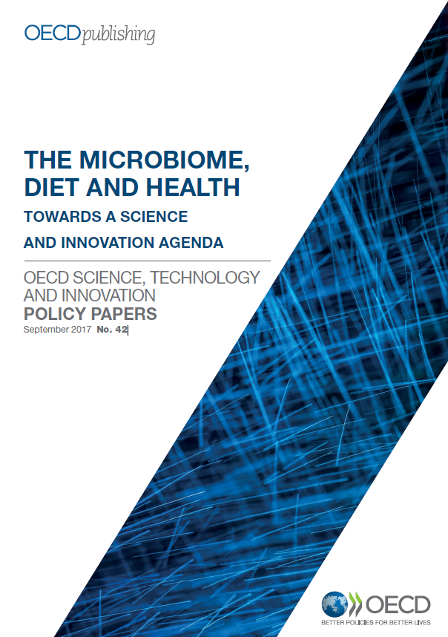
Gut Microbiome – Basics Right
BASELINE THOUGHTS
GOLD STANDARD, PRECEDENT, ANALOGY?
QUALITY, SAFETY, EFFICACY
TRANSFORMATIVE SCIENCE
«Healthy» Microbiome? Symbiosis? Dysbiosis? Patient or Microbiome?
Health & disease impact? define gaps
Dynamics, mechanism of action, physiologically relevant endpoints, individual metabolism (nutrition phenotyping to quantify “DNR”)
Regulate what: Safety 1st (pathogen free)? Large scale production; batch consistency? Classify non-gut systemic microbiome effect
Pro-, Pre-, Symbiotics / Antibiotics // 1st 1000 days, functional variability
Access: patients’, payers’ views?
Ruthsatz – Warsaw, November 2018

Slide 14
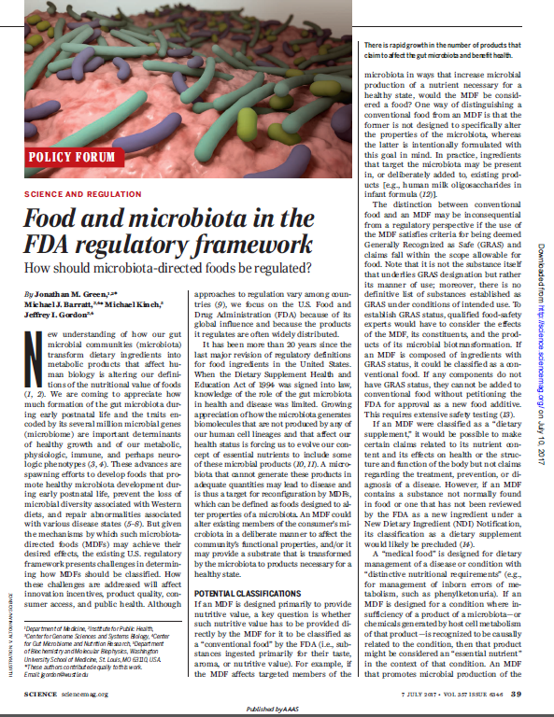
Regulatory Considerations: «Modify* the Gut Microbiome ..
Biological Drug
FSMP/ Medical Food (tube feeds or ONS)
Food Health Claim (EU NHCR Art.14; US)
... prevention, treatment, cure of IBD / … C.diff. »
… dietary management of IBD»
… risk (factor) reduction of IBD» (~«Disease Prevention»)
Food Health, S/F Claim
(EU NHCR Art.13; US CFR)
… normal bowel function / increase in faecal bulk»
* incl. e.g. FMT from healthy to sick individuals
Science (2017)
Ruthsatz – Warsaw, November 2018

Slide 15
Personalized Nutrition: Therapeutic Potential & Regulatory Challenges
(Personalized/Targeted) Nutrition in Health & Disease Management
  Microbiome
Regulatory Challenges
Ruthsatz – Warsaw, November 2018

Slide 16
Nutrition in Health & Disease Management
➔ The Big Decisions to Prepare for our Future HealthCare
Food Fortification
«Varied & Balanced»
Dietary Guidelines
DRI, NRV, EAR, UL, …
(age/gender/pregnancy …)
NCD Prevention
Disease Related
Malnutrition Management
Nutrition Therapy, Enteral & Parenteral Nutrition
HealthCare Professionals
Rare («Orphan») Diseases
NCD-NRVs …
Dietary/Food Supplements
Microbiome & technologies («omics», apps, 3D …)
WIN-WIN-4 «Citizens»
Improved Consumer & Patient Care
Reduced Health Systems Costs
Population Based Nutrition
Elevate Role of Nutrition
Personalize Nutrition
K E Y I S S U E S & H U R D L E S
Improve Status Quo (WHO/NCDs:
Diabetes, Dementias, CVDs, Cancers, …)
Regulatory & HealthCare Frameworks: Technical Barriers, Implementation
(Multiple Stakeholders)
Regulatory, Science Technology, Media ➔ Health-Disease Continua, Speed
Ruthsatz – Warsaw, November 2018

Slide 17
Game Changing Solutions:
Fit-4-Purpose Regulatory Framework 4 «Citizens»
➔ An innovation minded, efficient, sustainable healthcare environment
CURRENT REGULATORY FRAMEWORK
CONTINUOUS IMPROVEMENT & FOCUS ON WHAT WORKS
- less on mechanisms or dogmatic interpretation of regulatory categories
IMPLEMENT GOOD PRACTICE
Regulated HealthCare Categories: Food, Drug, Medical Device, Cosmetic. In case of doubt ➔ it’s a drug
Remove unnecessary technical barriers (harmonize/converge rules globally (Codex et al): CMC, GMP …)
New («omics») diagnostics challenge «health-disease» categories (-50% people «diseased»/CTs; NRVs)
Disease Prevention (1) solves problems before they occur, yet lacks incentive [e.g. just 3% EU R&D investment (i.e. remainder on medicinal treatments)] (2) should not automatically equal «Drug»
Co-existence of «averaging» plus «personalizing» nutrition plus medicine (holistically)
Rules average requirement based; personal physiological needs may differ (individual health vs. homeostasis vs. disease states) ➔ Both approaches can co-exist, no «over-personalizing»
Optimal Nutrition Care for All (ONCA) multistakeholder campaign: Every patient who is malnourished or at risk of undernutrition is systematically screened & has access to appropriate, equitable, high quality nutritional care’ (18 European Countries)
Microbiome follows regulatory principles of «quality, safety, efficacy» ➔ Yet: Baseline & (Un-)Certainty?
Efficacy based on (total) Evidence (= incl. RCTs); «Personalize Averages»: NCD NRVs, N-of-1 studies ...
https://european-nutrition.org/
Ruthsatz – Warsaw, November 2018

Slide 18
A Conclusion: Elevate the Role of Nutrition
NUTRITION IS ESSENTIAL IN HEALTH & DISEASE MANAGEMENT
PUBLIC INTEREST: USE NUTRITION POTENTIAL IN A «21st CENTURY» WAY
Nutrition is safe, physiologic, nourishes (!) citizens AND is cost-efficient, can be personalized, a sole or additional solution to maintain health & for disease risk reduction/ prevention/ malnutrition/ management.
(1) No over-personalization needed (2) Microbiome = an extra target & partner
Food Supplements: shift focus from «consumer safety» to «citizen health» (= including safety)
Increase incentives for the development of nutrition solutions ➔ Accelerate current approaches &
prepare for unexpected “disruptive”, cost-efficient solutions (“omics”, wearables, IT/ Big data, …)
“Health 1st”: innovatively interpret/enforce regulations for citizens, use «precautionary» approach wisely
➔ We can’t afford not to use low-risk healthcare nutrition solutions
➔ Need a constructive «pre-mortem» multi-stakeholder dialogue
Use Power of Nutrition (Therapy) complementing drugs («prevent/treat/cure disease»)
Disease-related malnutrition (DRM in EU: 170Bn€/y) ➔ Patient Access: measure + implement solutions
Ruthsatz – Warsaw, November 2018

Slide 19
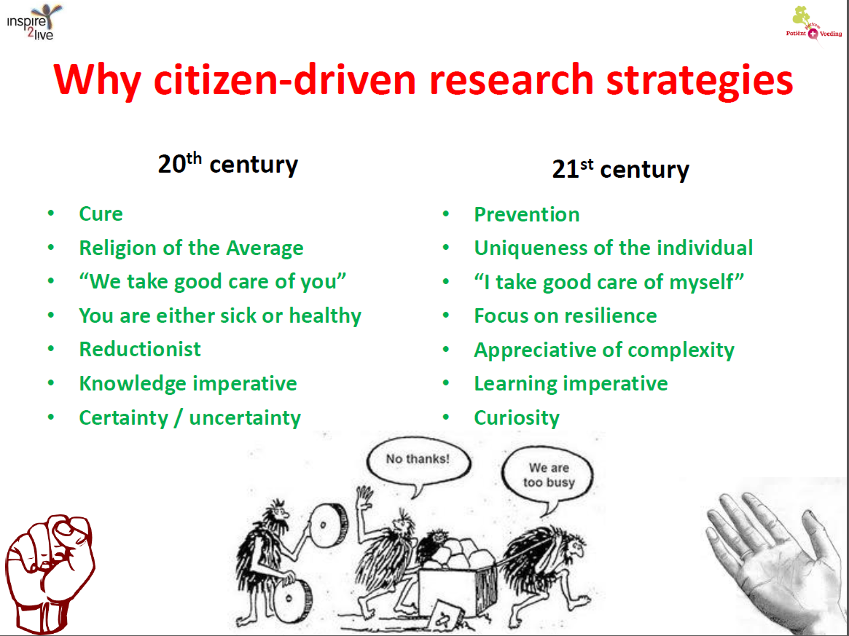

A Conclusion (2): An (Im)Patient Citizen’s View
NCDs & Economy*: We don’t have another 20 years to think & act then
Next Steps
Increase Incentives: Converge/ Decomplexify Rules (common sense, less dogmatic)
Invest into Science & Technology
Guidance & confidence building
Implement what we know: ONCA
*DRM: costs 170Bn€ p.a. (EU)
Diabetes: ~1/2Bn patients globally
Ruthsatz – Warsaw, November 2018
Ruthsatz – IUFoST, Mumbai, October 2018

Slide 20
